Slide 1
Data visualisation using R
Andy Baker

Slide 2
This session
The main aim of this session is to spark ideas and inspire further learning. There are no prerequisites and there is no expectation to fully understand any code yet.
Agenda:
Introduction into data visualisation in R with the ggplot2 package
A full walkthrough of the “evolution” of a plot using vaccination data
Fancy showcase: R packages designed as extensions to ggplot2
Where and how to learn more
Slide 2

Slide 3
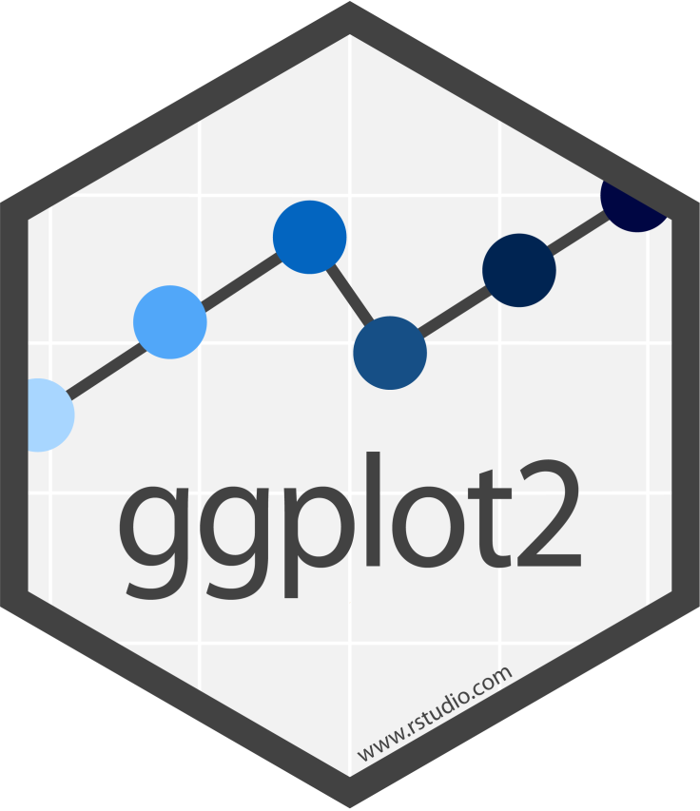
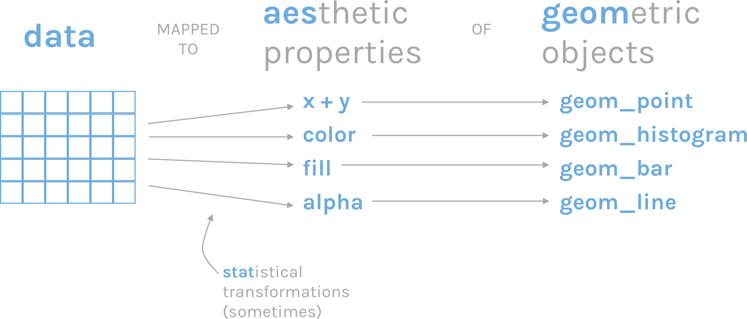
R’s flagship data visualisation package:
This package is based on the “grammar of graphics”, allowing you to map data to aesthetics of geometric objects
Slide 3
Notes:
Image: https://rfortherestofus.com/wp-content/uploads/2019/07/grammar-of-graphics.png

Slide 4
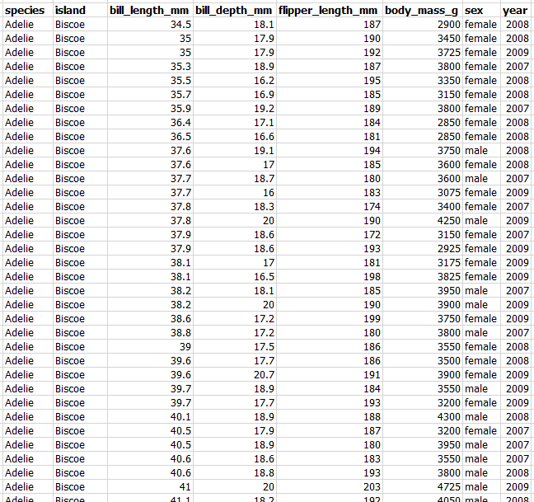
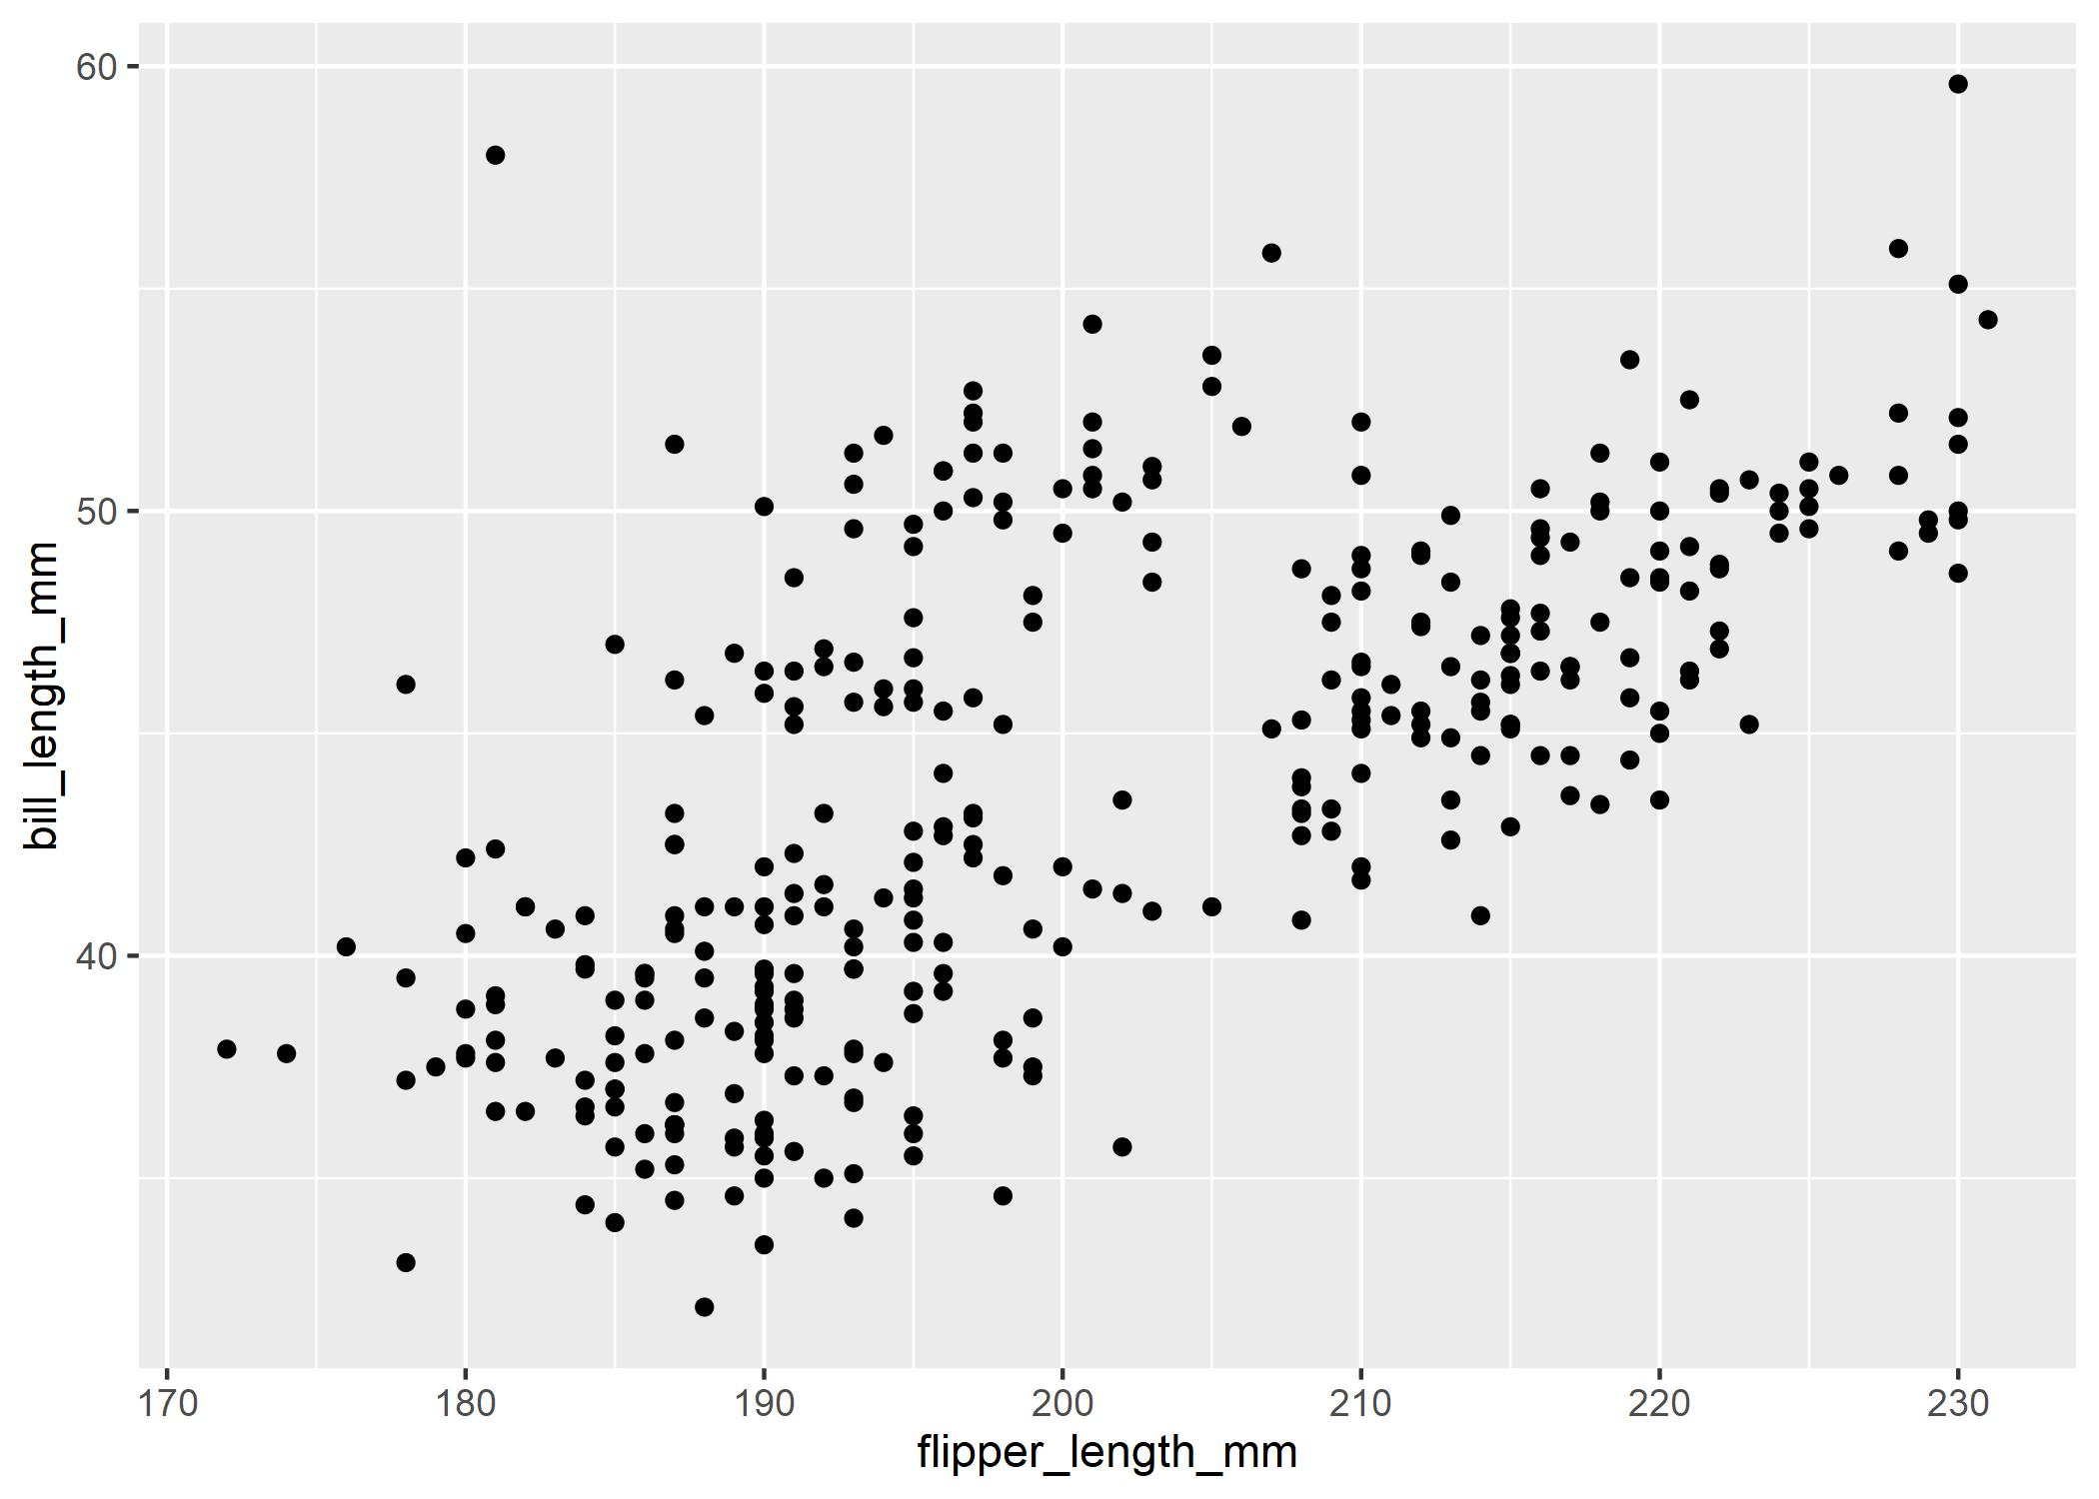
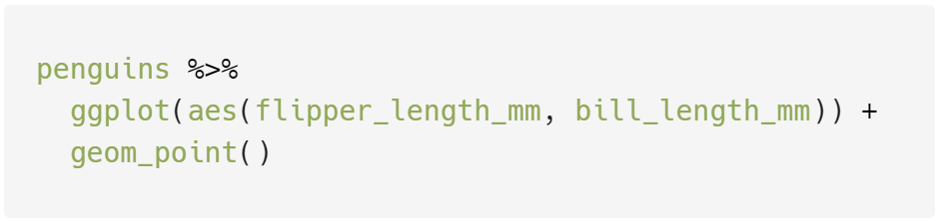
Data
The visualisation
R code (using the ggplot2 package)
Slide 4

Slide 5
Slide 5

Slide 6
1. The example dataset is already assigned to an object called penguins
2. Two aesthetic properties, x and y coordinates, are given within the ggplot() function
3. The geom_point() function specifies the geometric object we’d like to plot
For now, feel free to completely ignore syntax like %>% and +
Slide 6
Notes:
Syntax details, for those interested…
The “flow” of data is represented by the pipe operator: %>% After ggplot(), + is used instead.
This quirk is due to ggplot2 being older than the version of R that introduced the pipe.

Slide 7
Slide 7

Slide 8
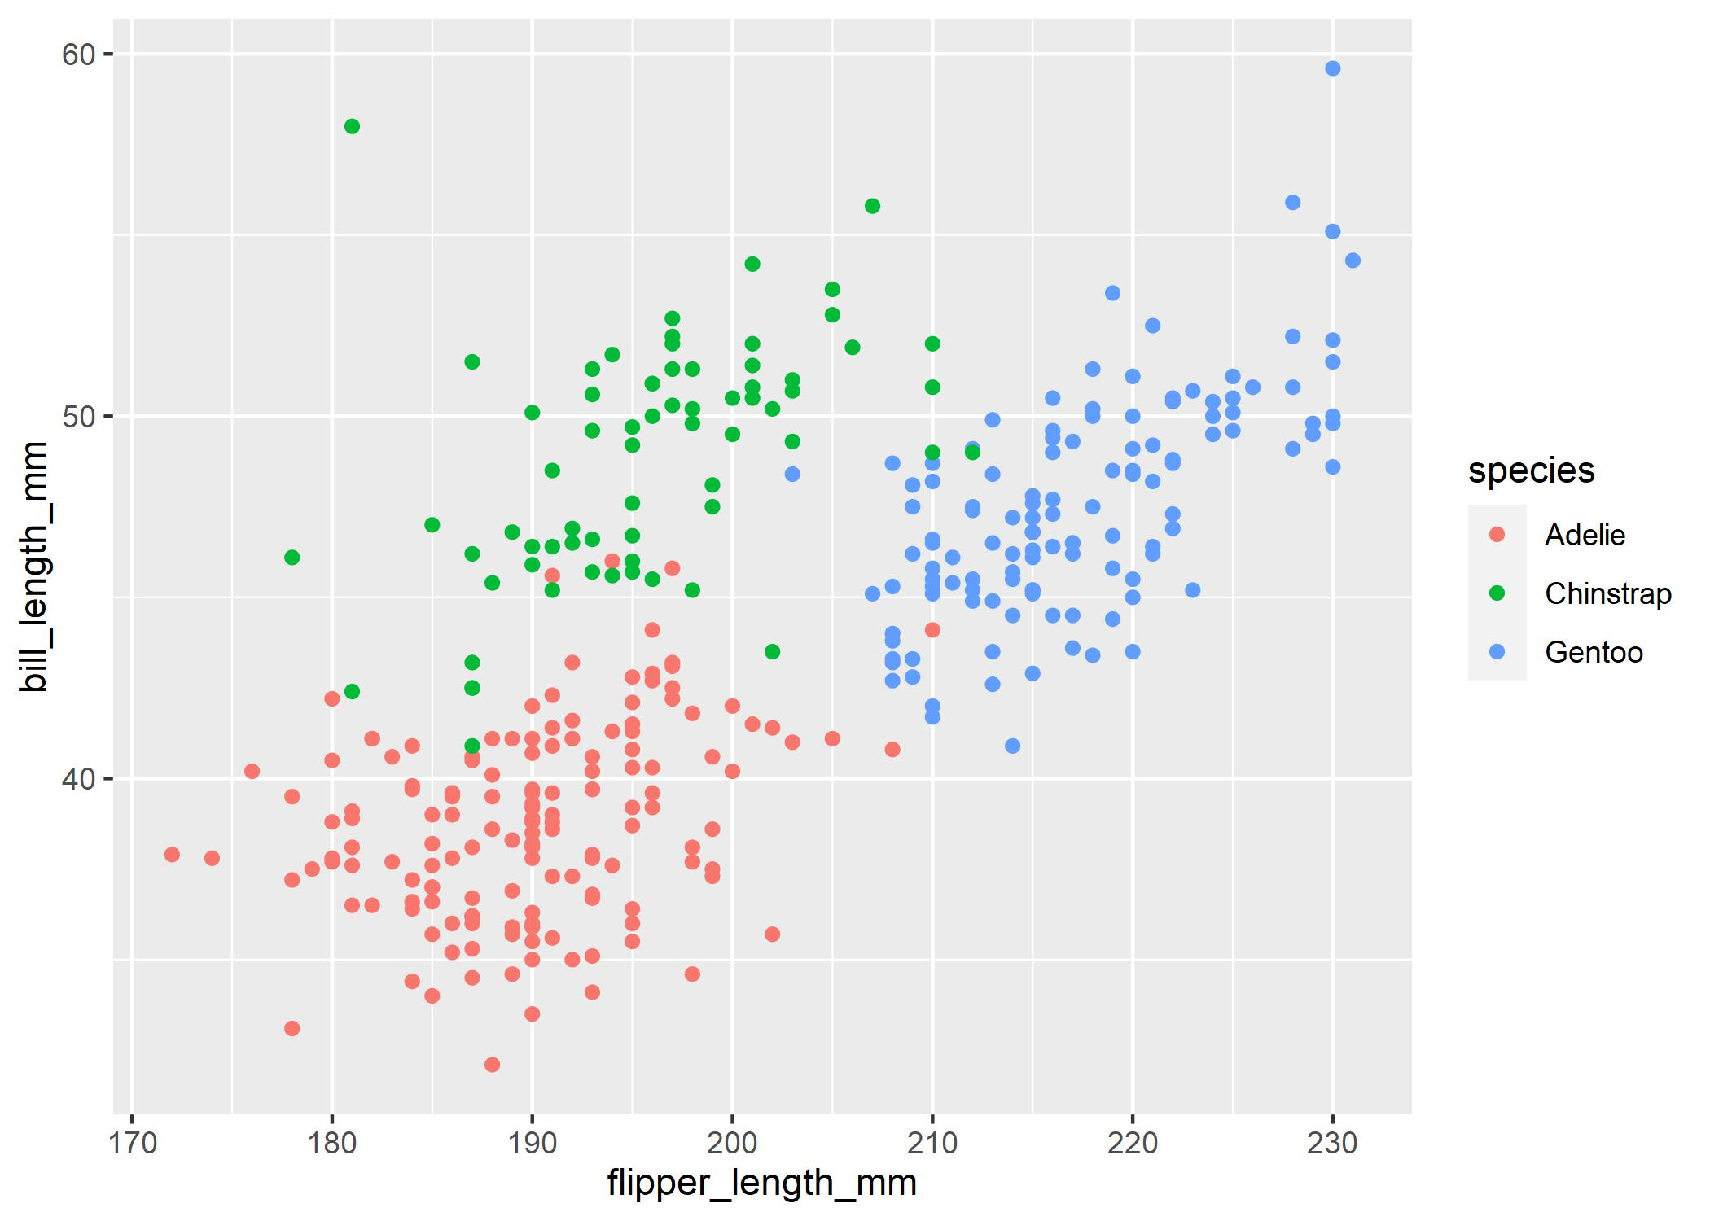
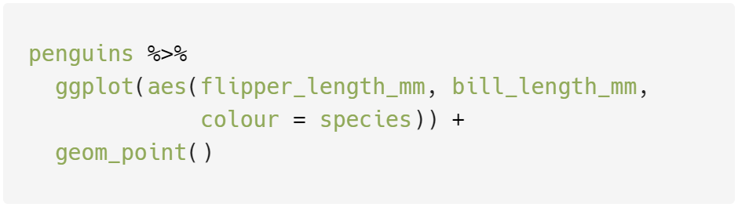
Mapped the species variable to the colour aesthetic
Slide 8

Slide 9
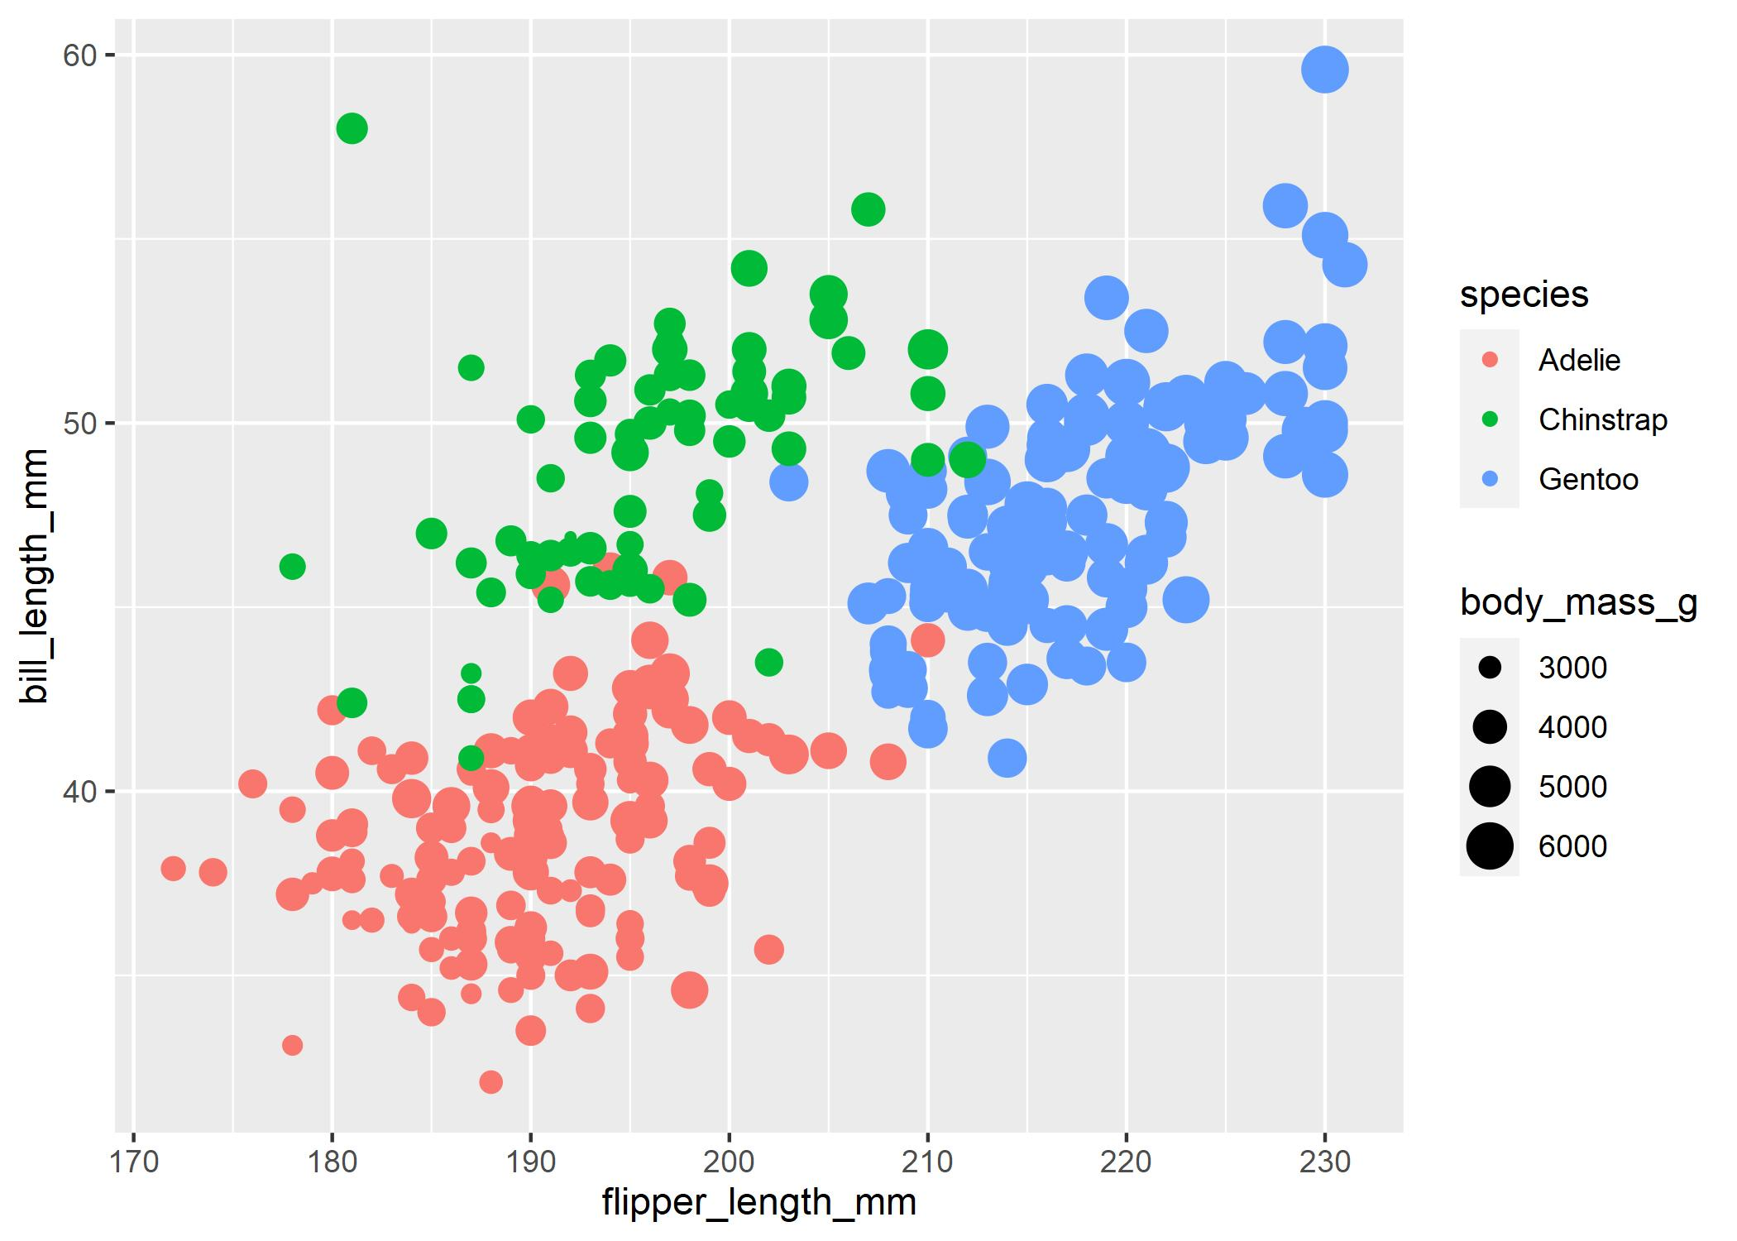
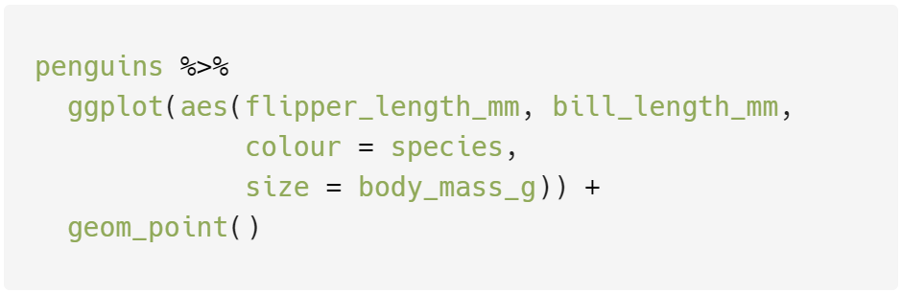
Mapped the body_mass_g variable to the size aesthetic
Slide 9

Slide 10
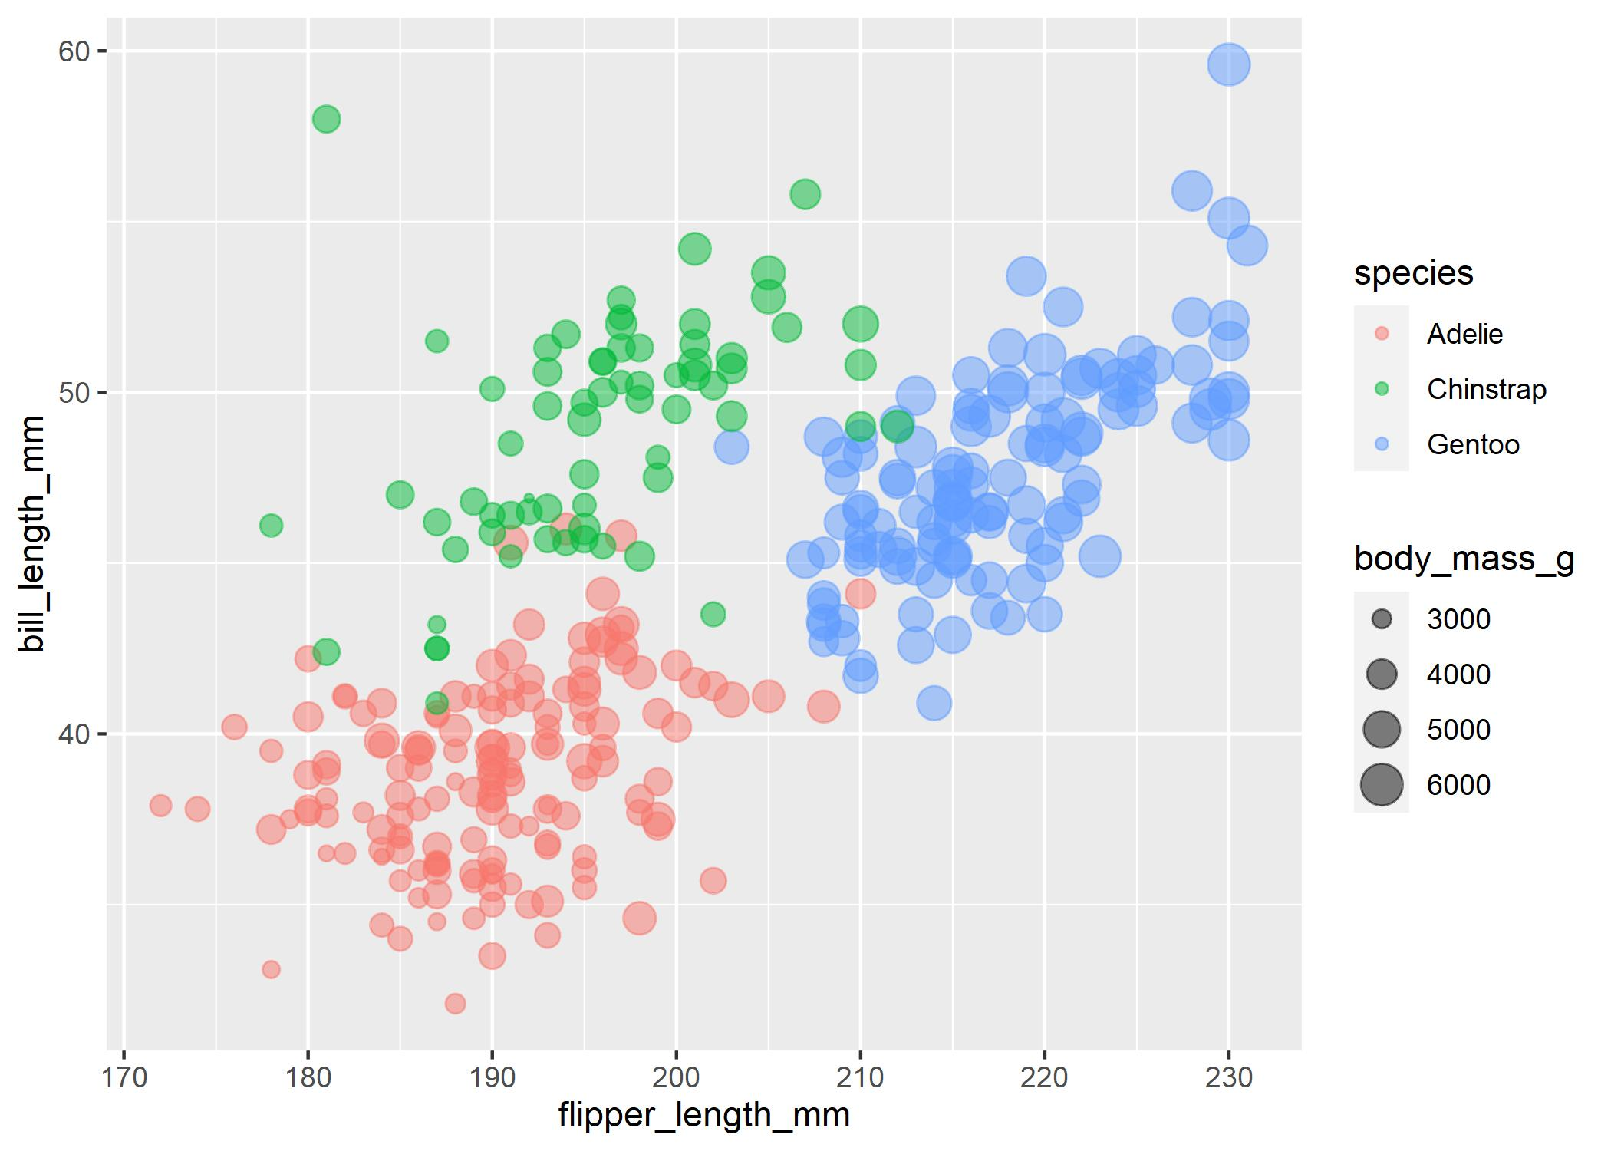
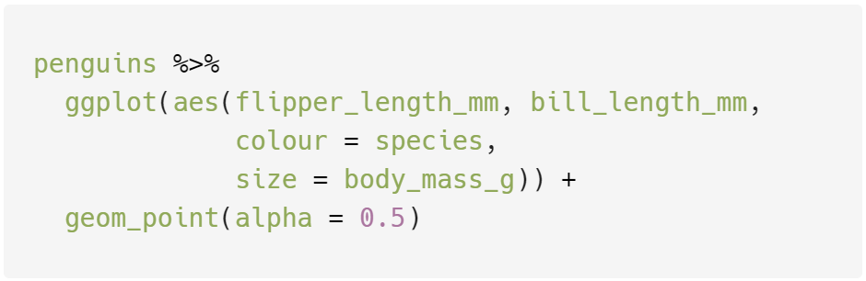
Set the transparency (alpha) of the points to 50%
Slide 10

Slide 11
What can ggplot2 do?
This hugely popular R package can be used to make a wide variety of visualisations.
Quick showcase: All of the following visualisations were made using ggplot2…
Slide 11

Slide 12
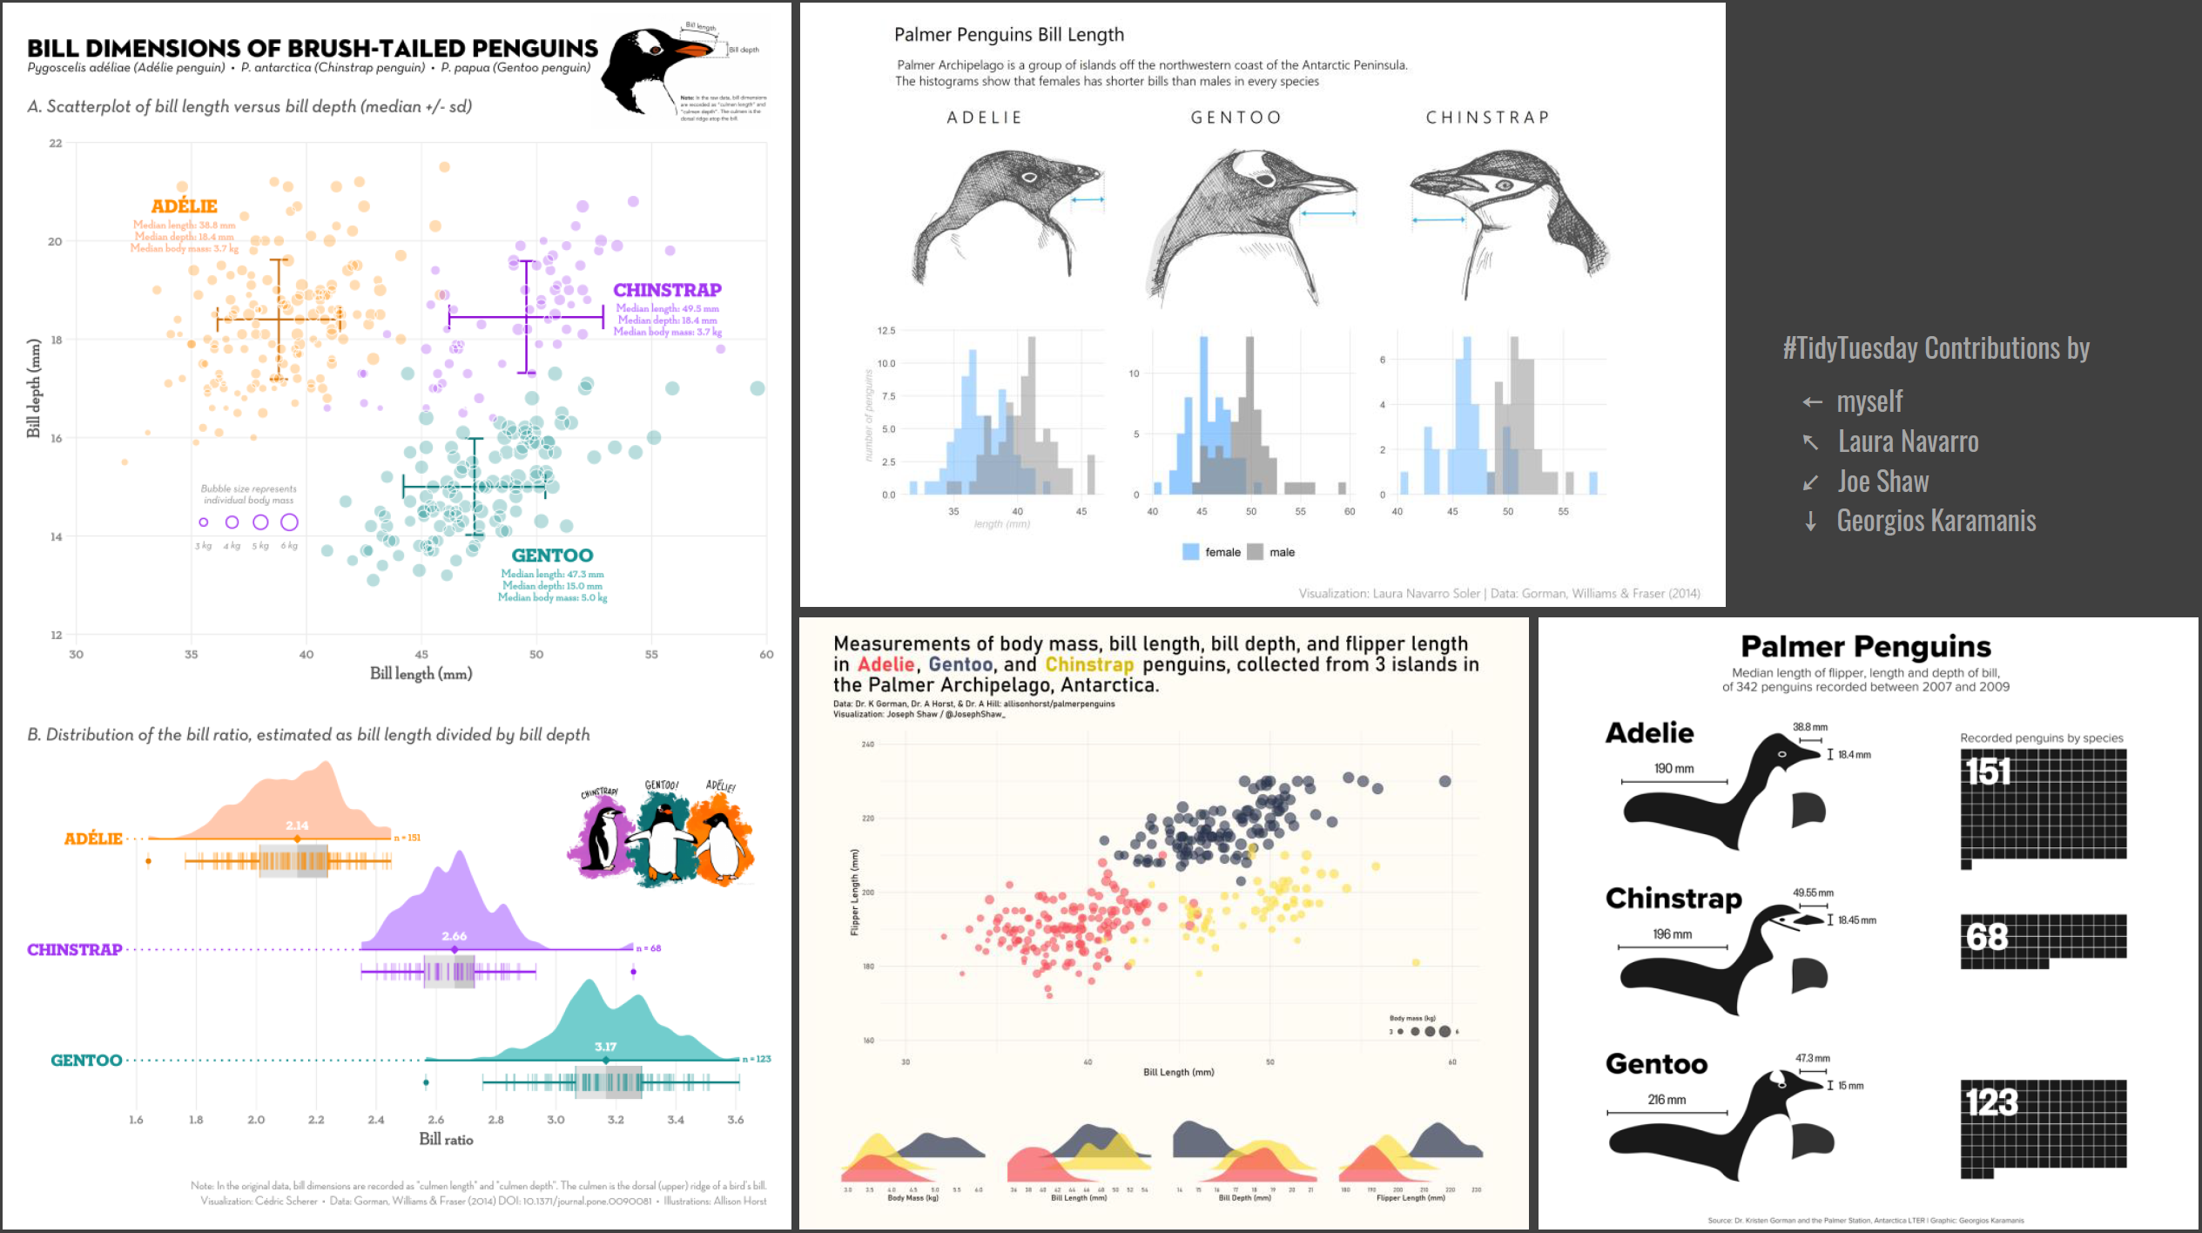
The penguin data set
Notes:
https://github.com/z3tt/OutlierConf2021

Slide 13
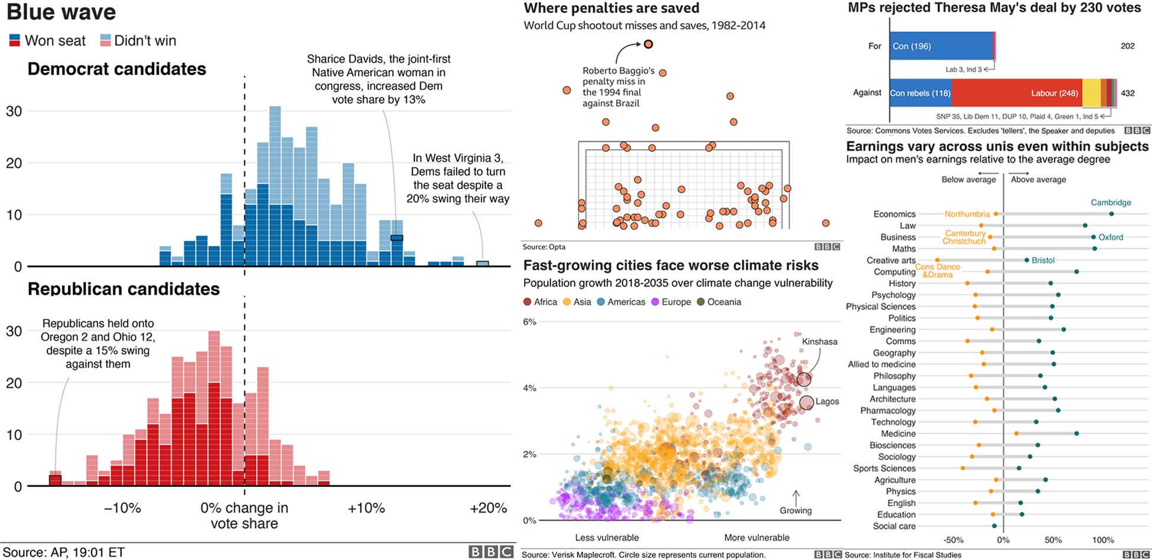
The BBC data team use ggplot2 for their visualisations:
Notes:
https://bbc.github.io/rcookbook/

Slide 14
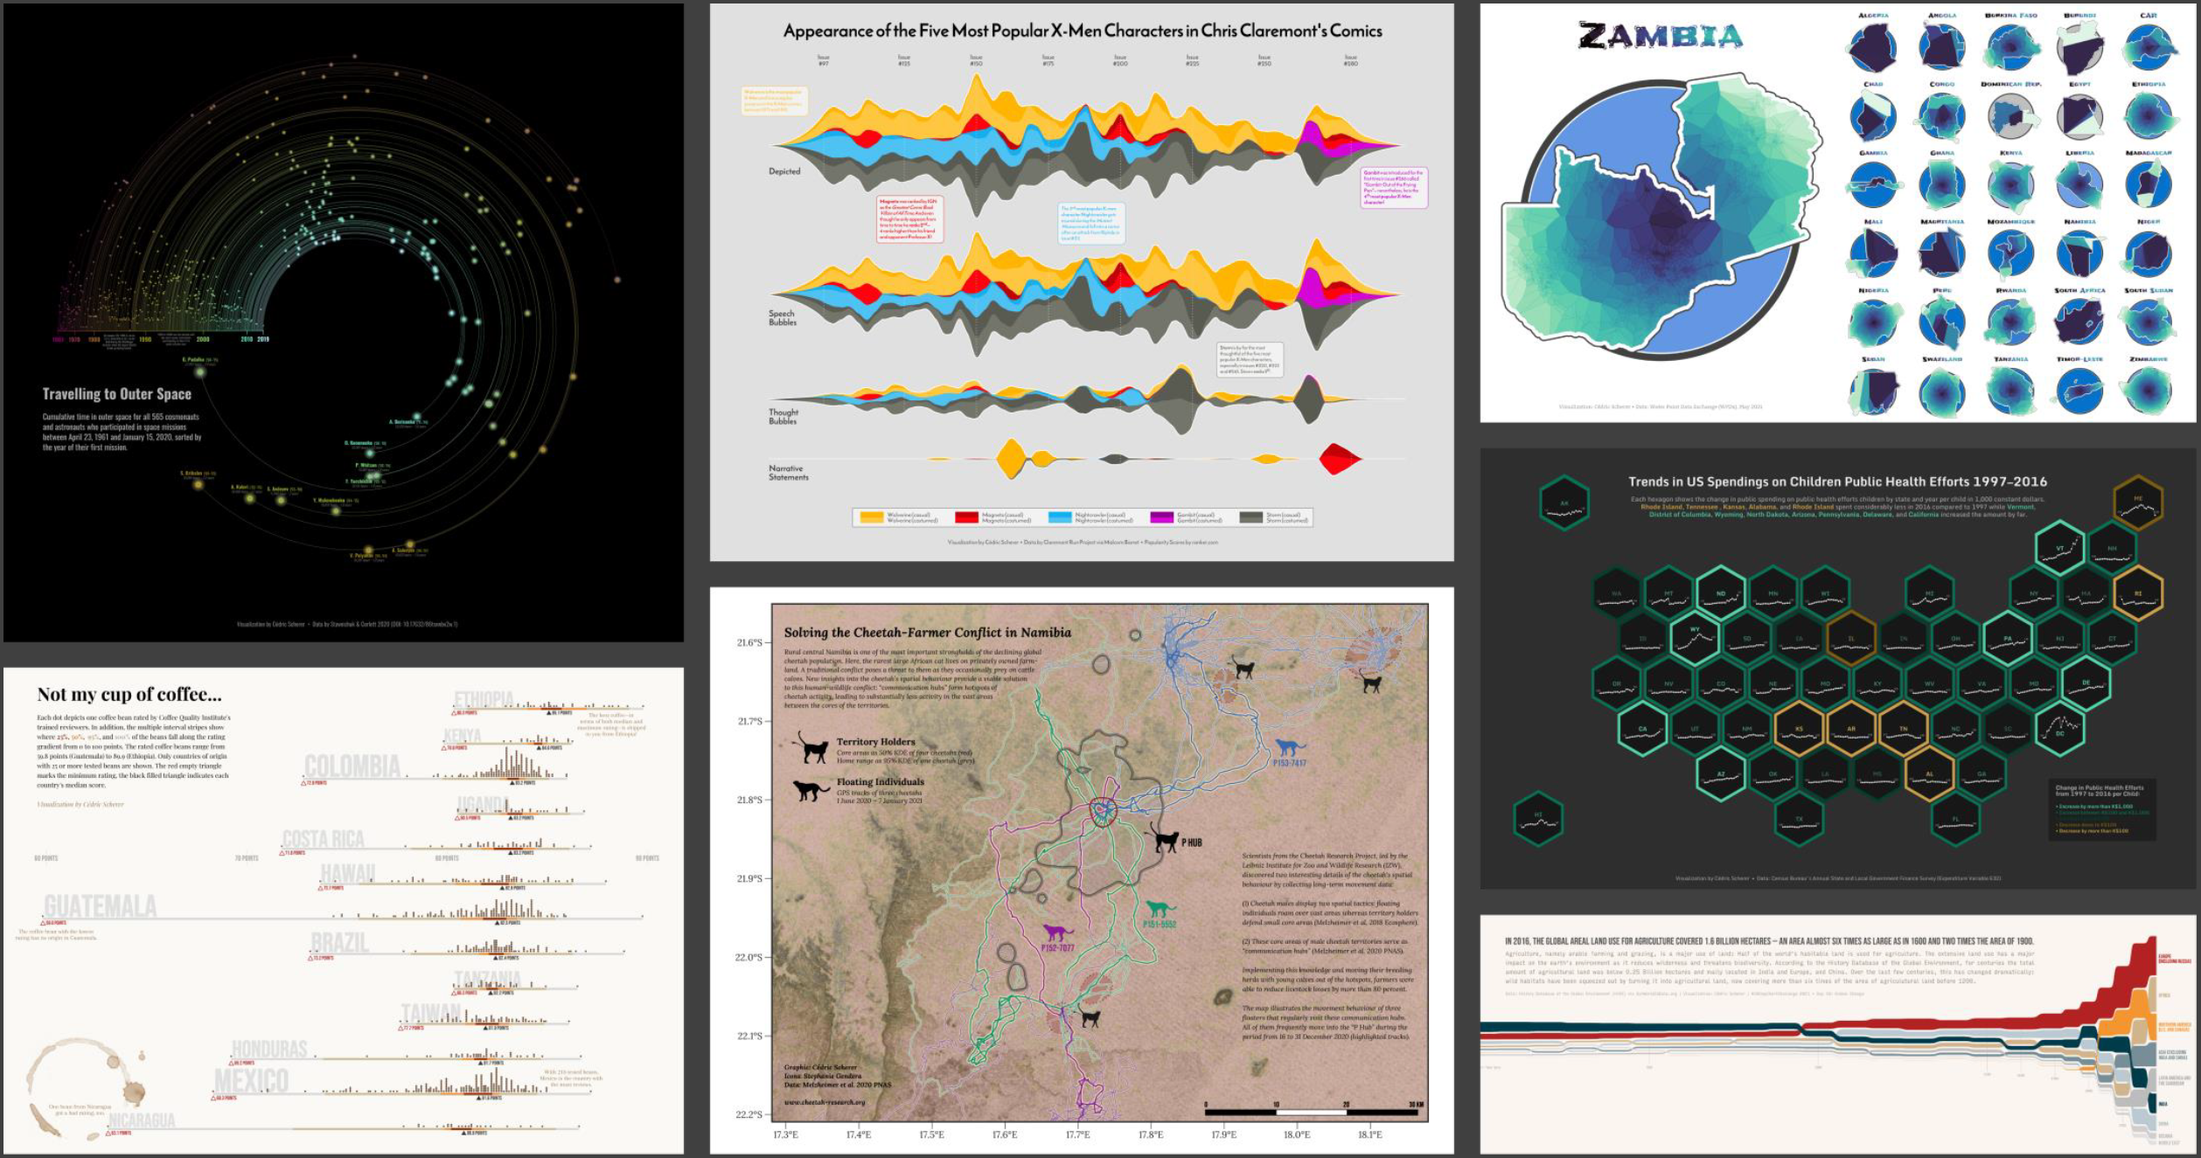
All of these visualisations were made in R using ggplot2
Notes:
https://www.cedricscherer.com/slides/RLadiesTunis-2021-favorite-ggplot-extensions.pdf

Slide 15
Example using ggplot2 with covid vaccination data
Slide 15

Slide 16
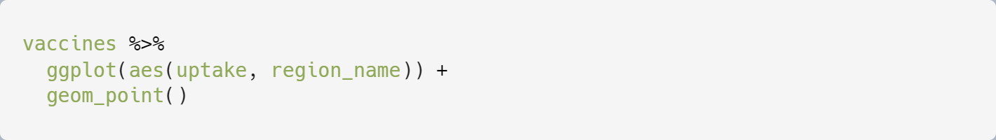
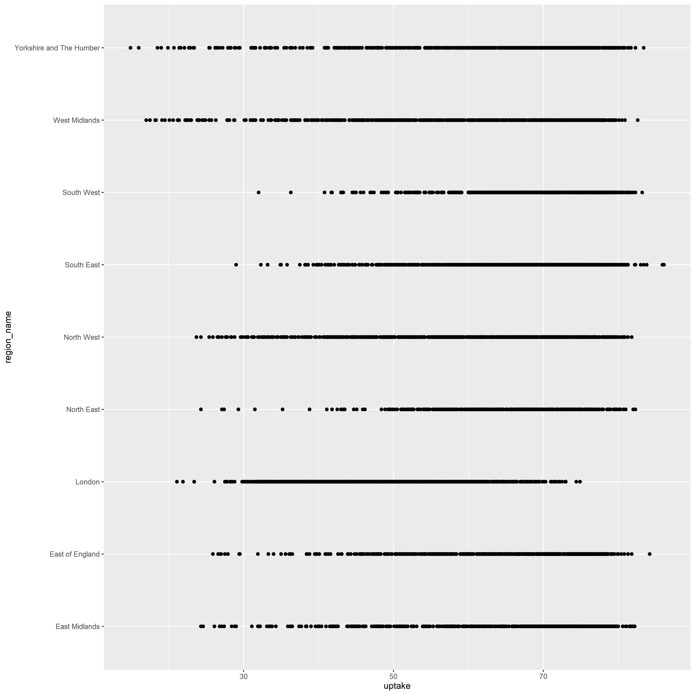
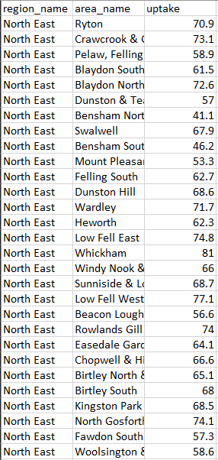
R code (using ggplot2)
The visualisation
Data
Slide 16

Slide 17
Plotted the % 3rd covid-19 vaccination uptake of MSOAs across regions of England with geom_point()
Slide 17

Slide 18
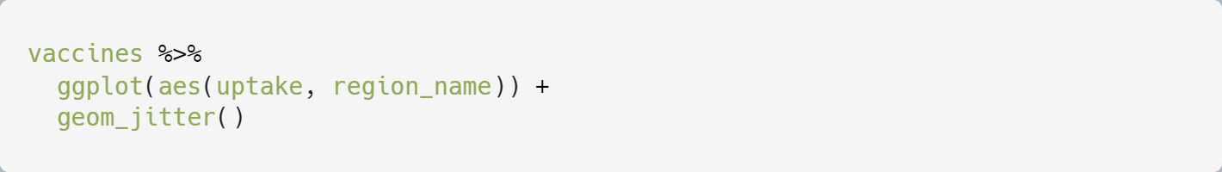
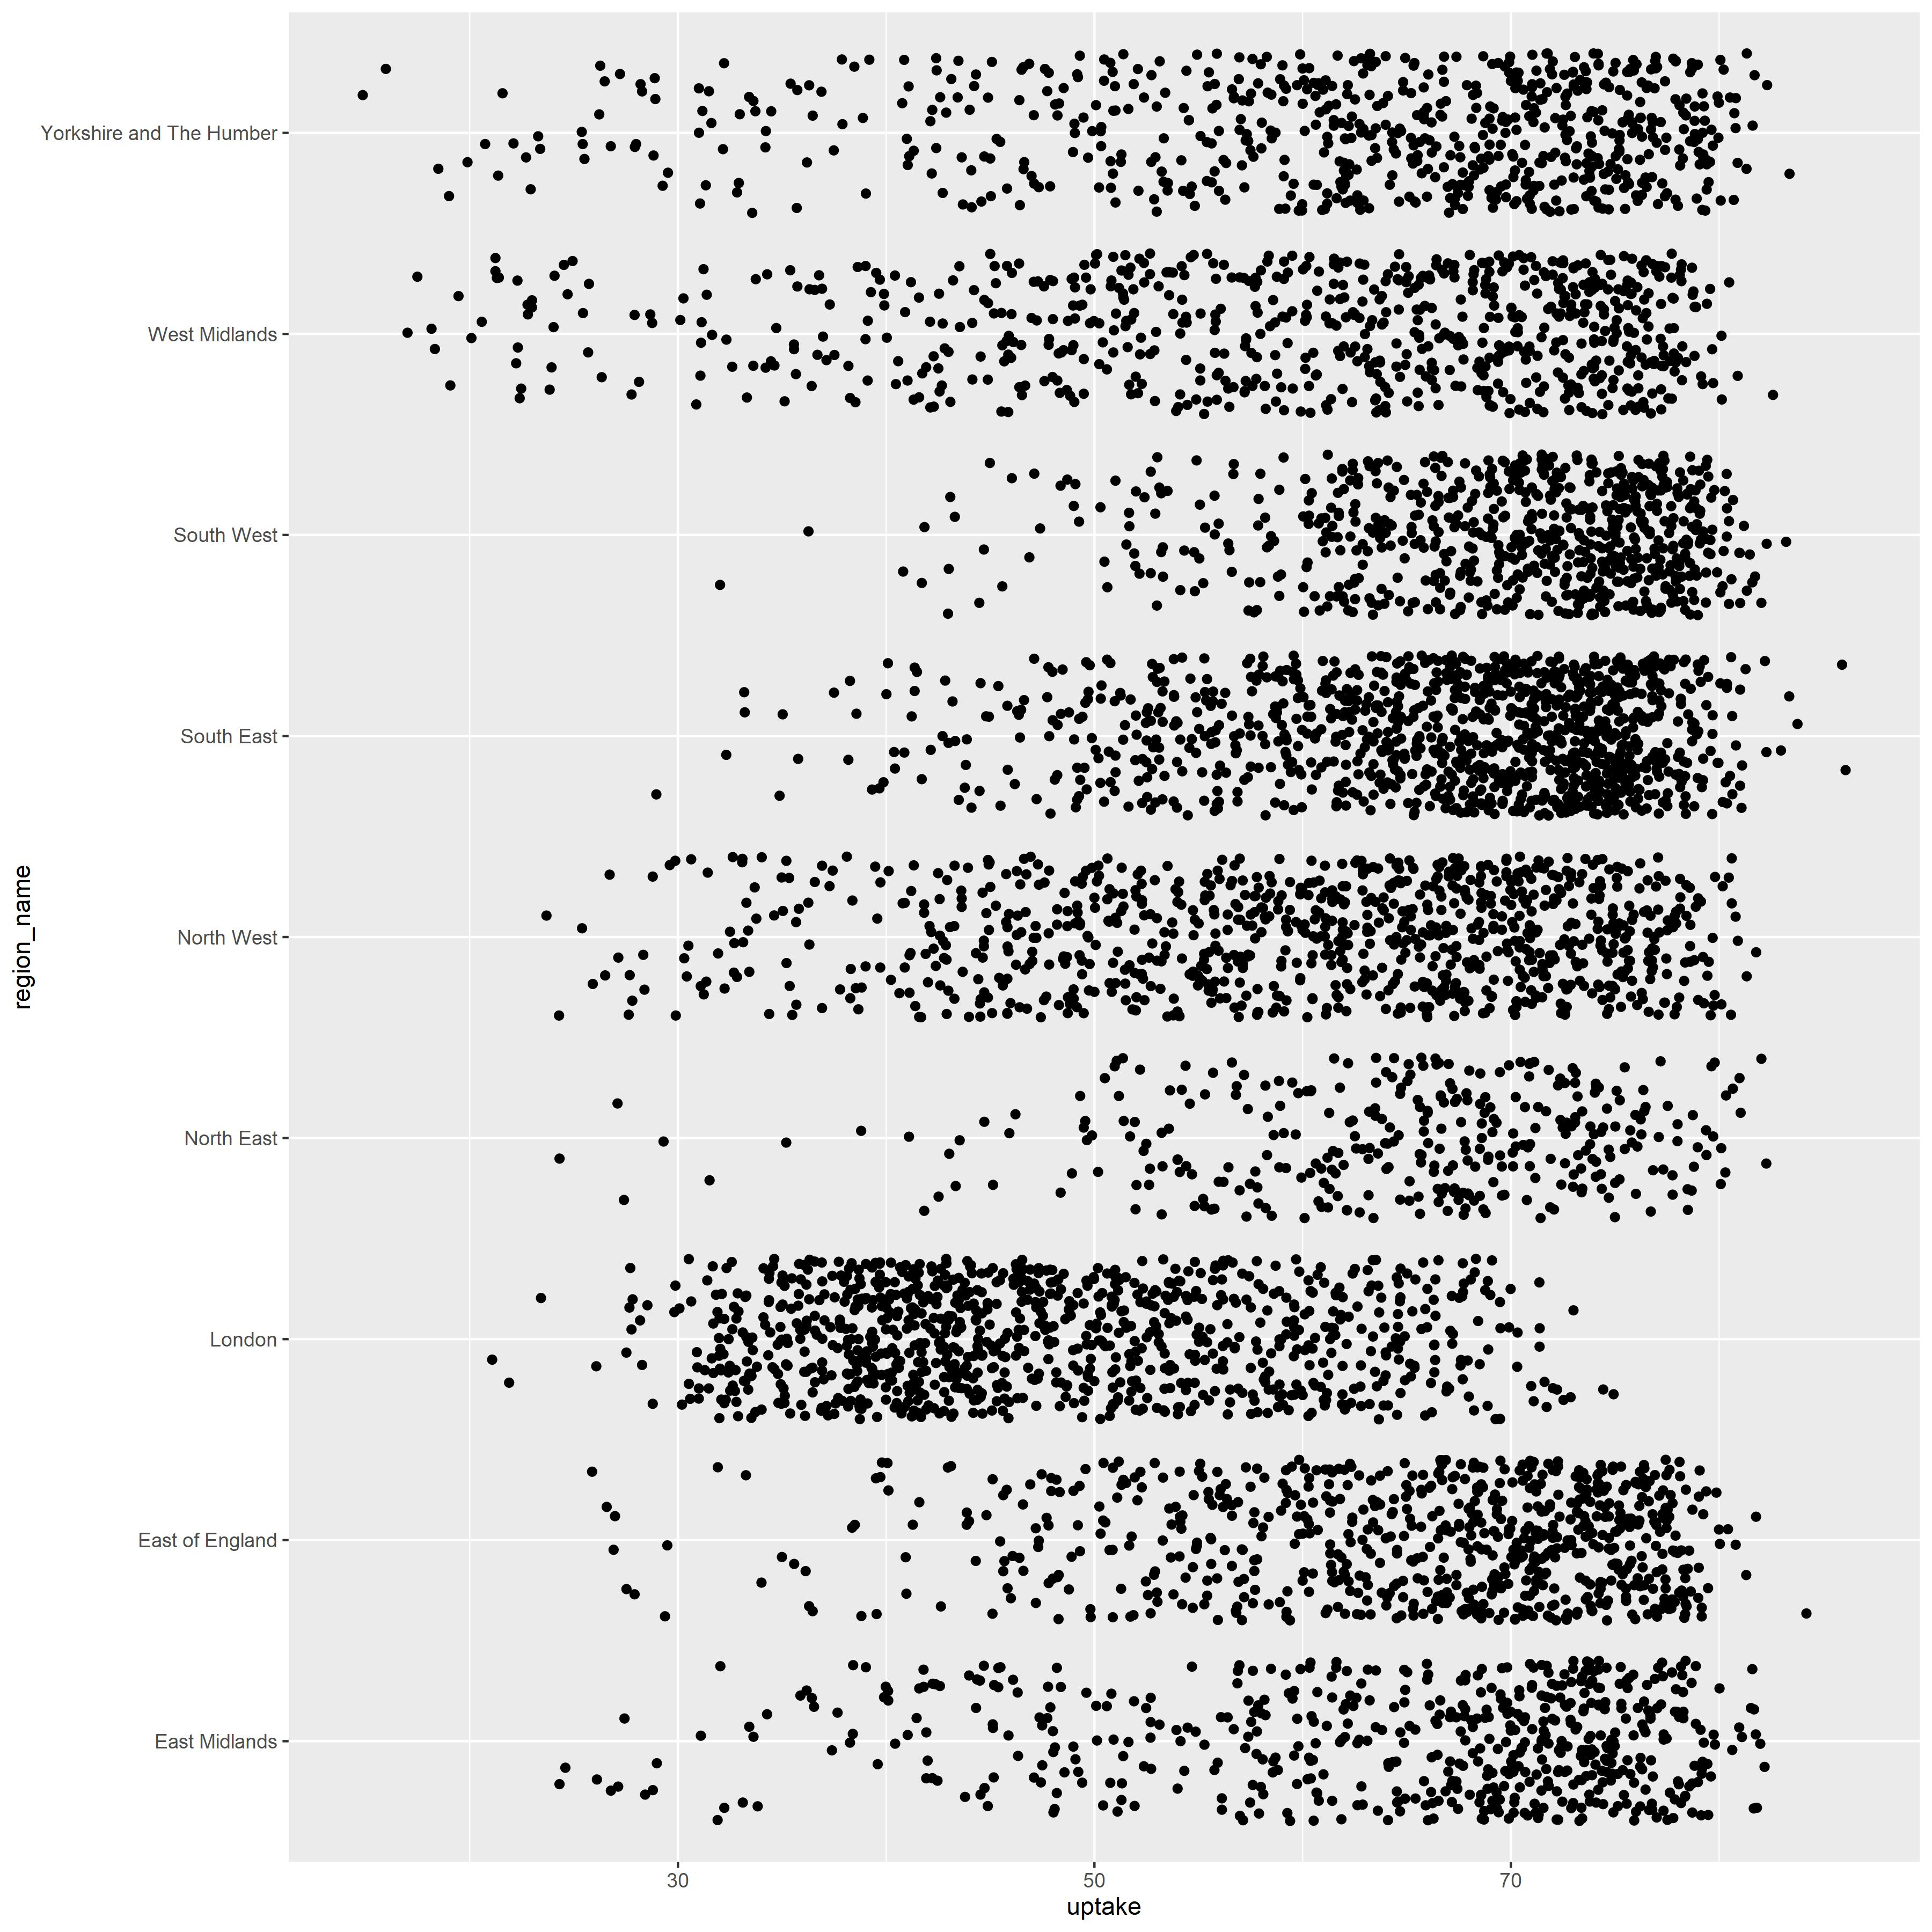
Replaced geom_point() with geom_jitter() to “jitter” the points and reduce overplotting.
Slide 18

Slide 19
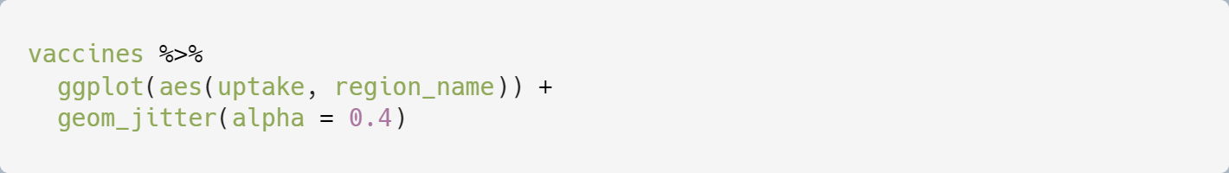
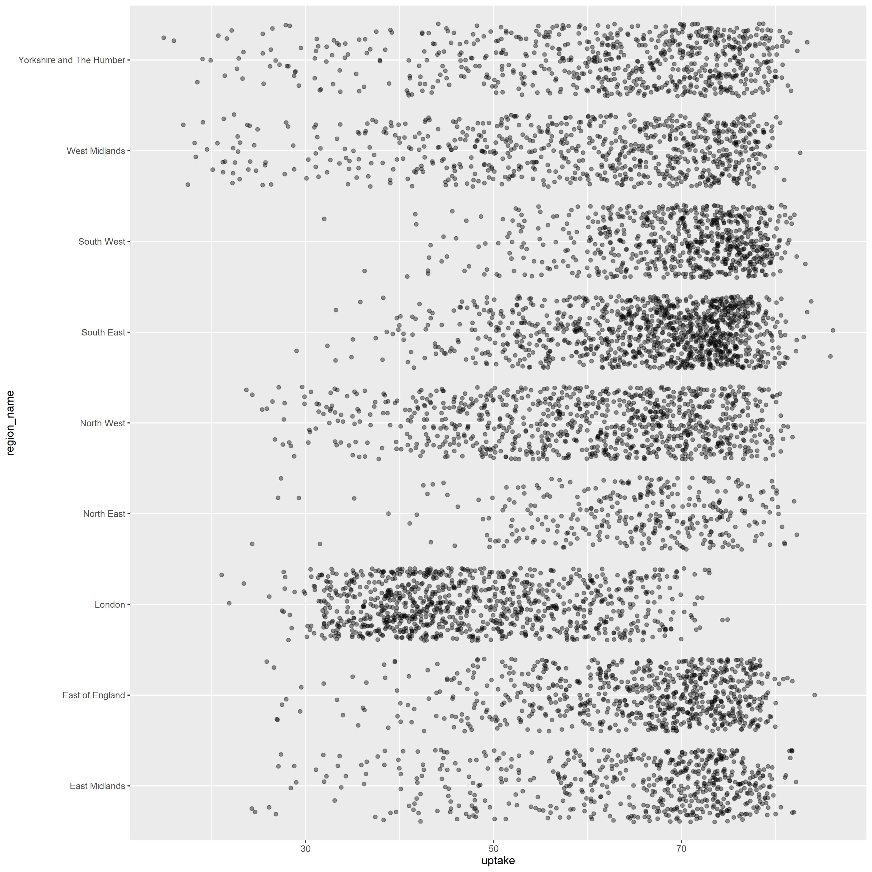
Set point transparency to 40% to reduce overplotting further
Slide 19

Slide 20
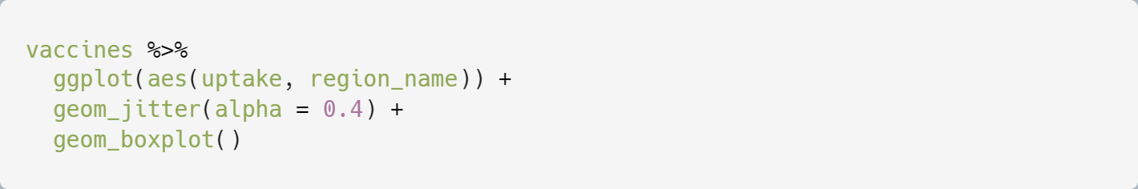
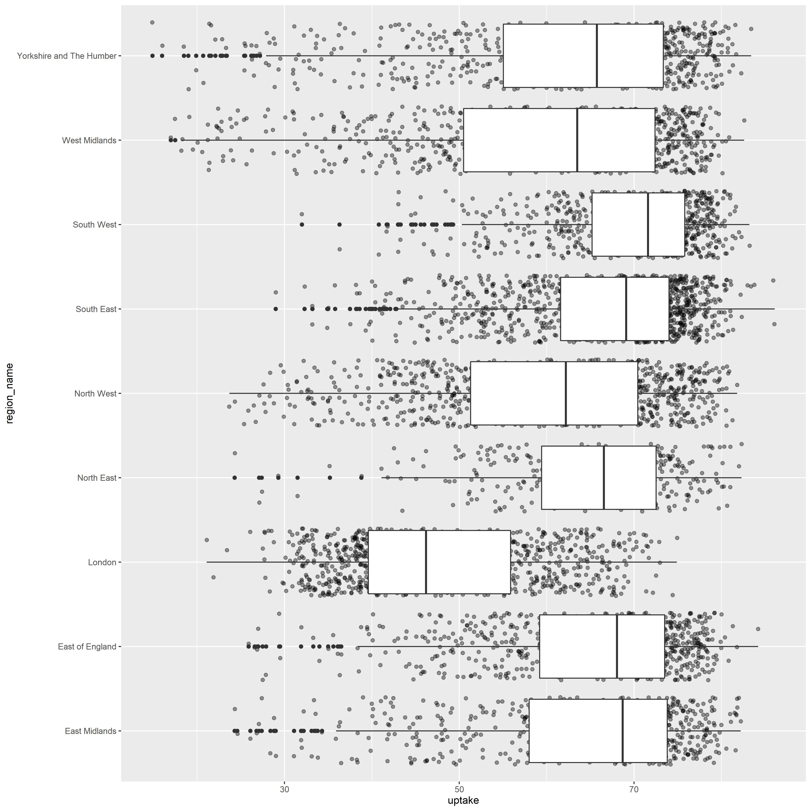
Added boxplots with geom_boxplot()
Slide 20

Slide 21
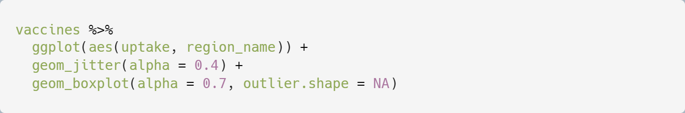
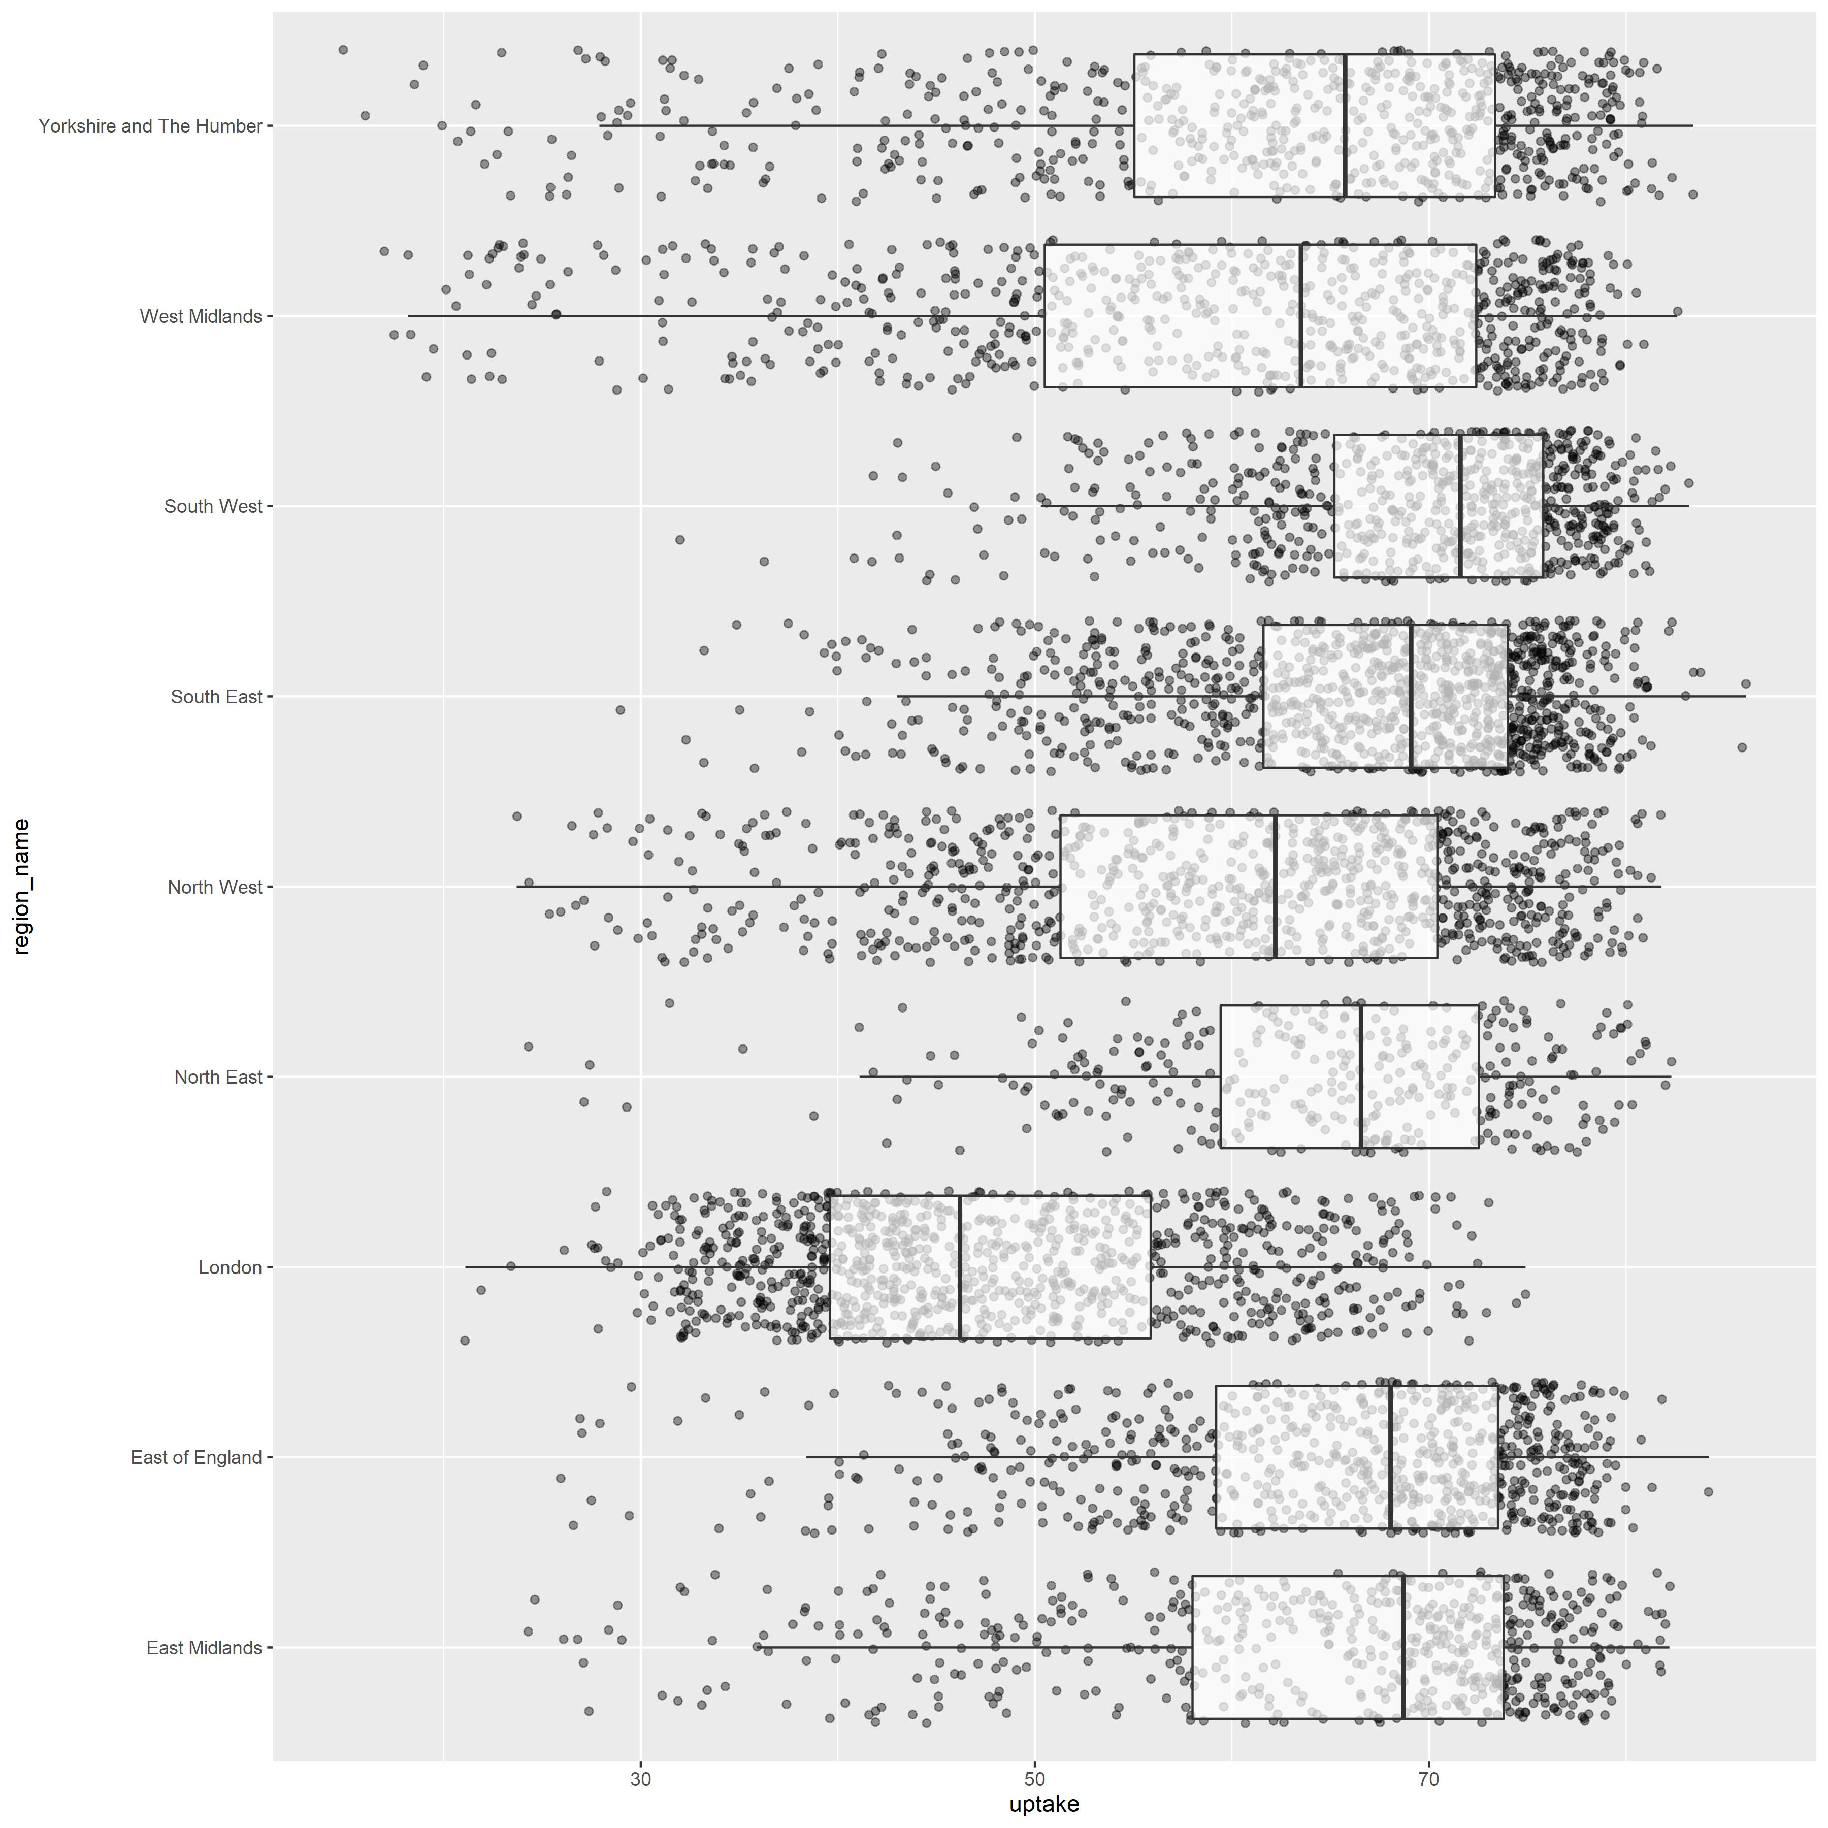
Set boxplot transparency and removed duplicate outliers
Slide 21

Slide 22
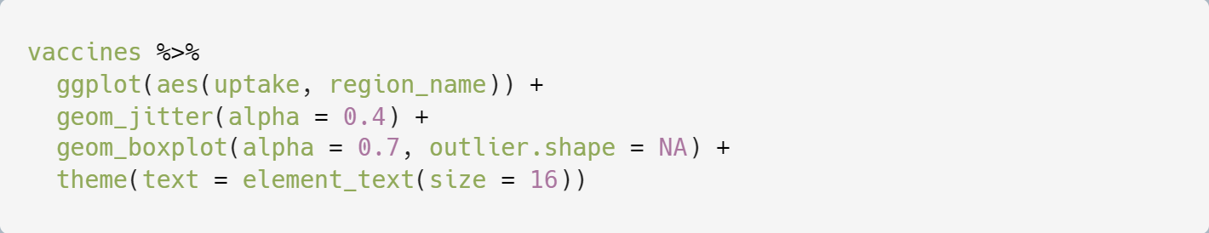
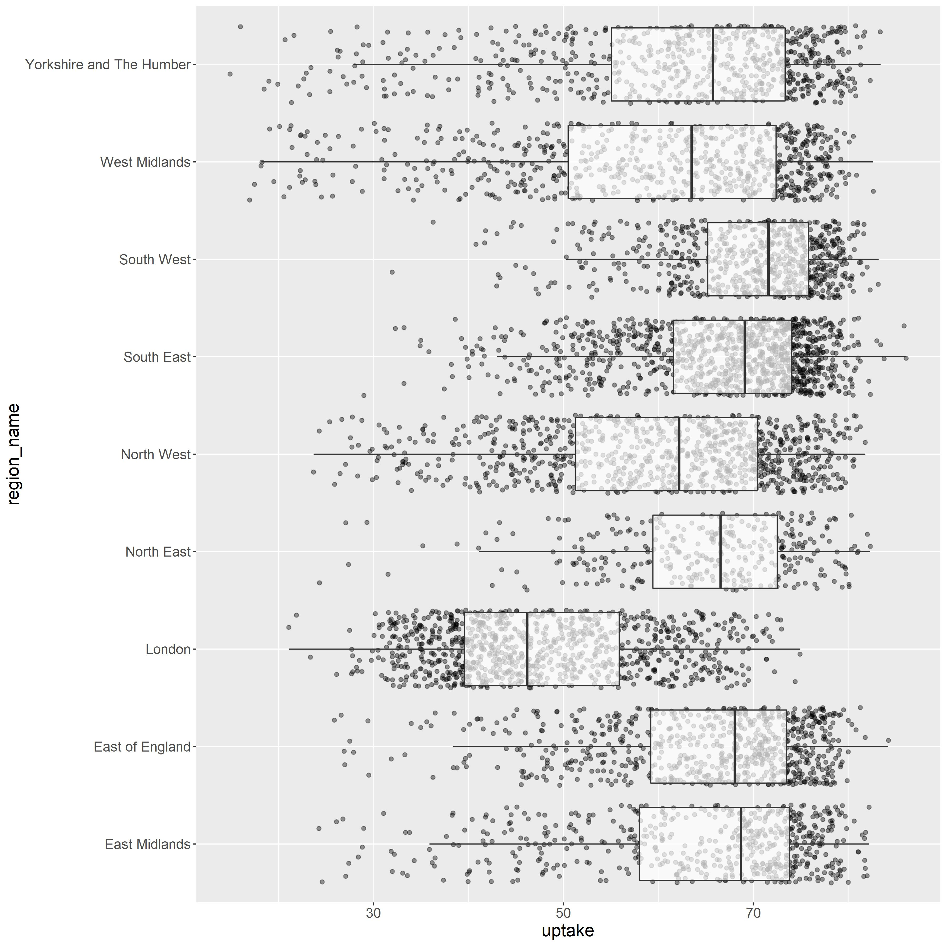
Increased text size with theme()
Slide 22

Slide 23
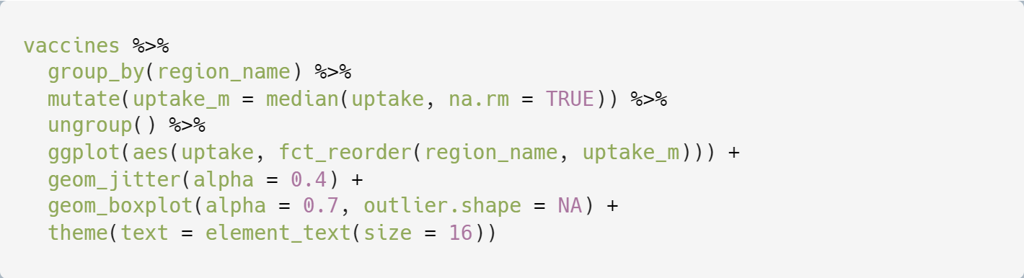
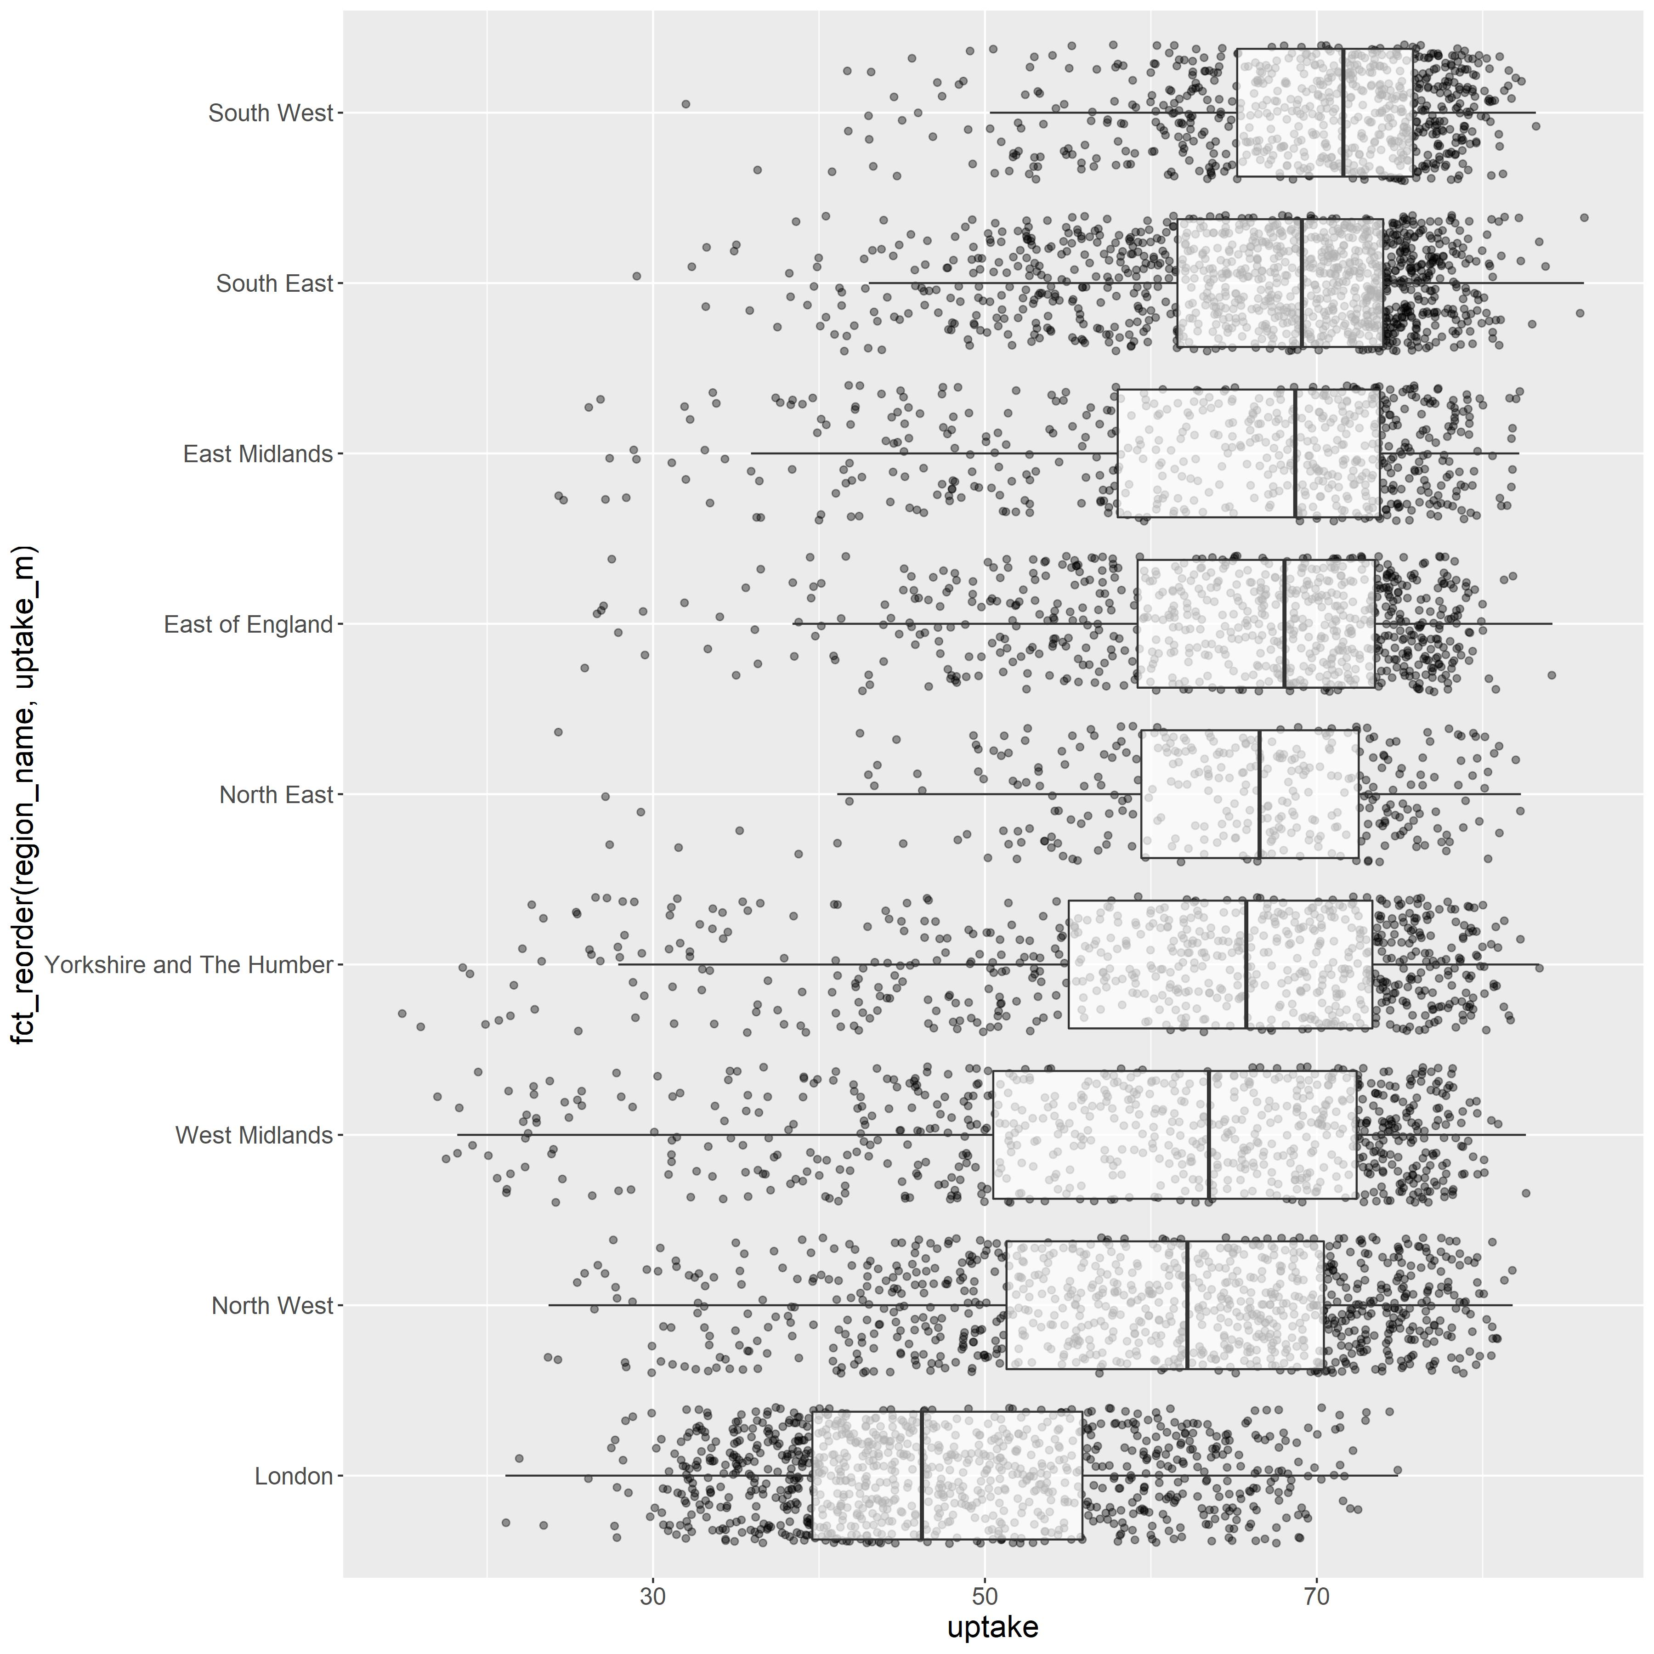
Ordered by median % uptake
Slide 23

Slide 24
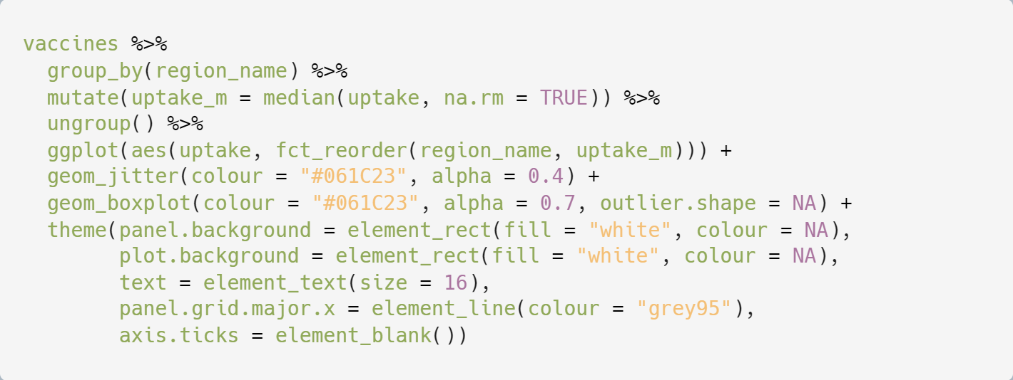
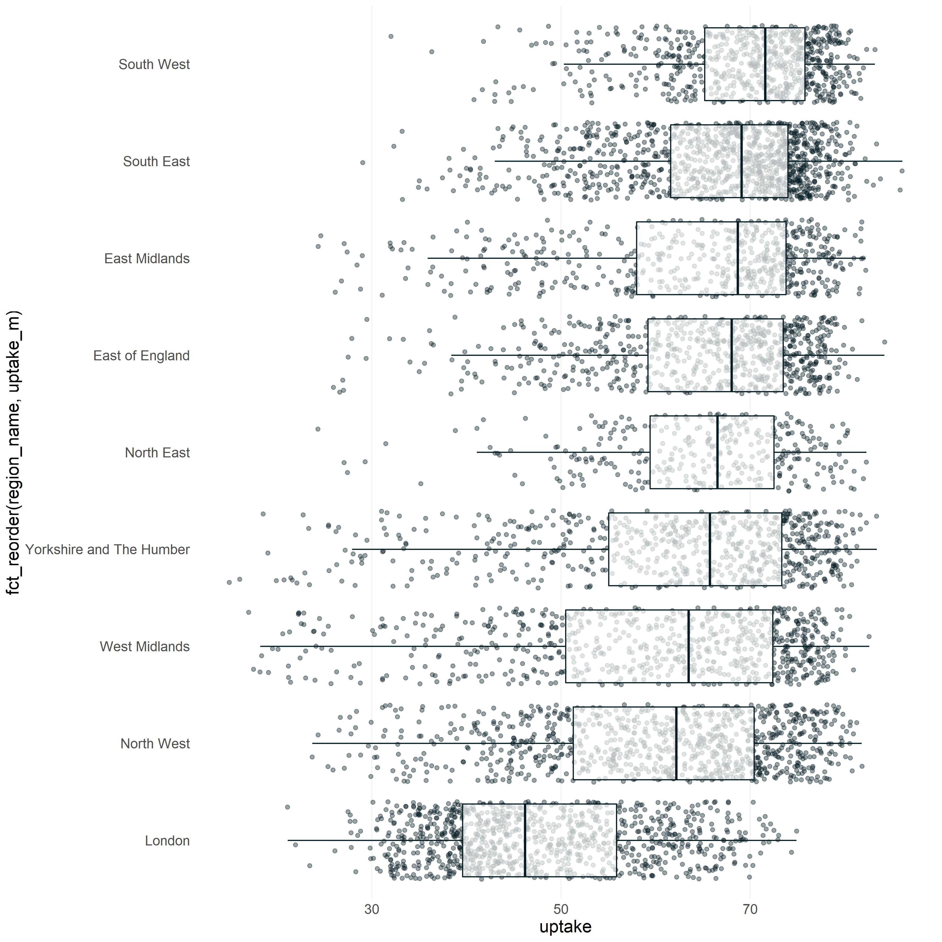
Decluttered by altering the theme() to remove extra gridlines, remove axis ticks, and change the background to white.
I also altered some colours to suit a DHSC style.
Slide 24

Slide 25
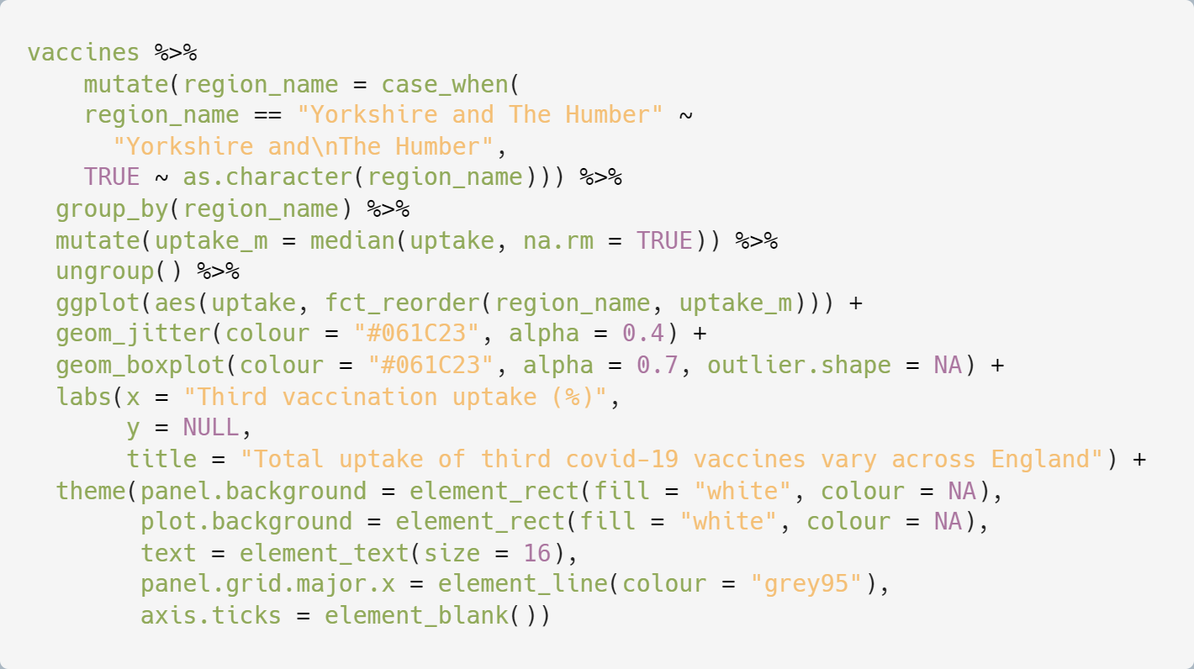
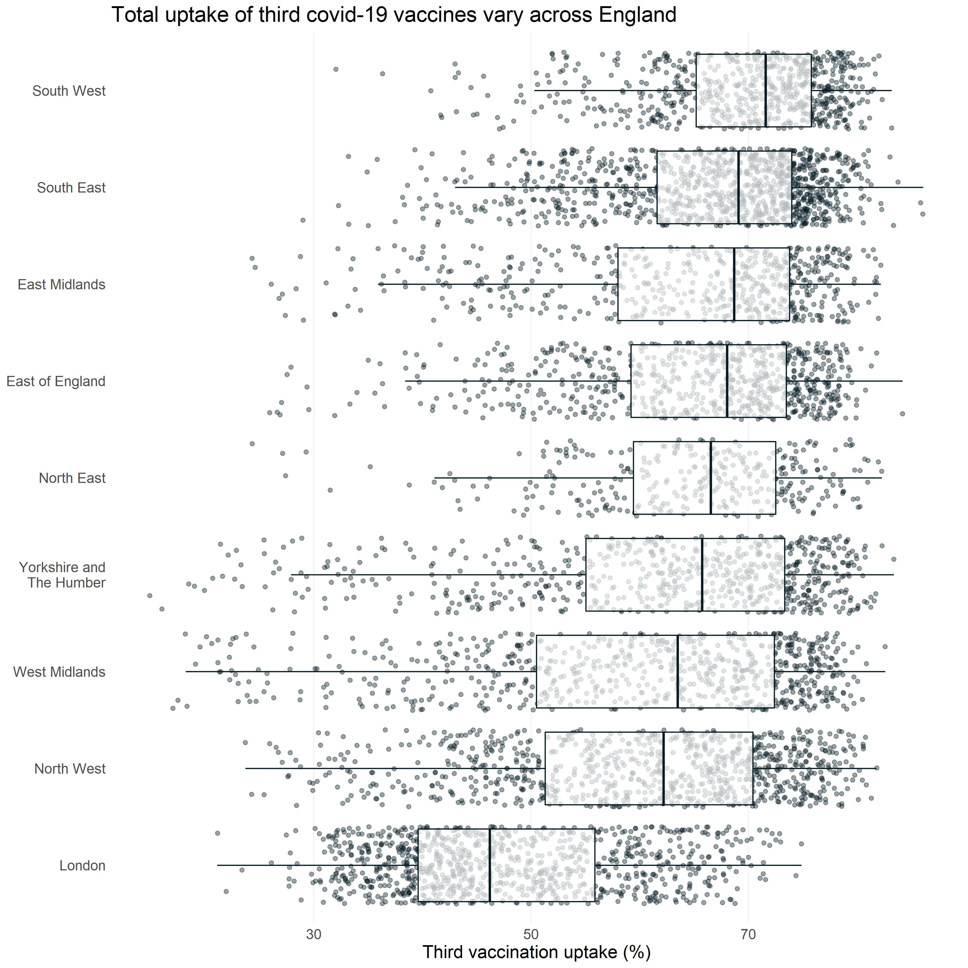
Added a title and corrected axis text with labs()
Slide 25

Slide 26
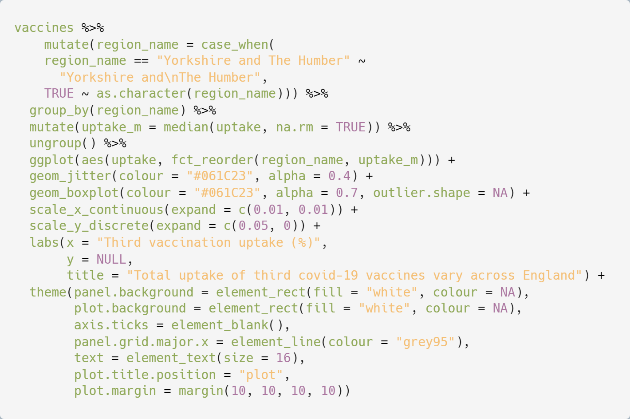
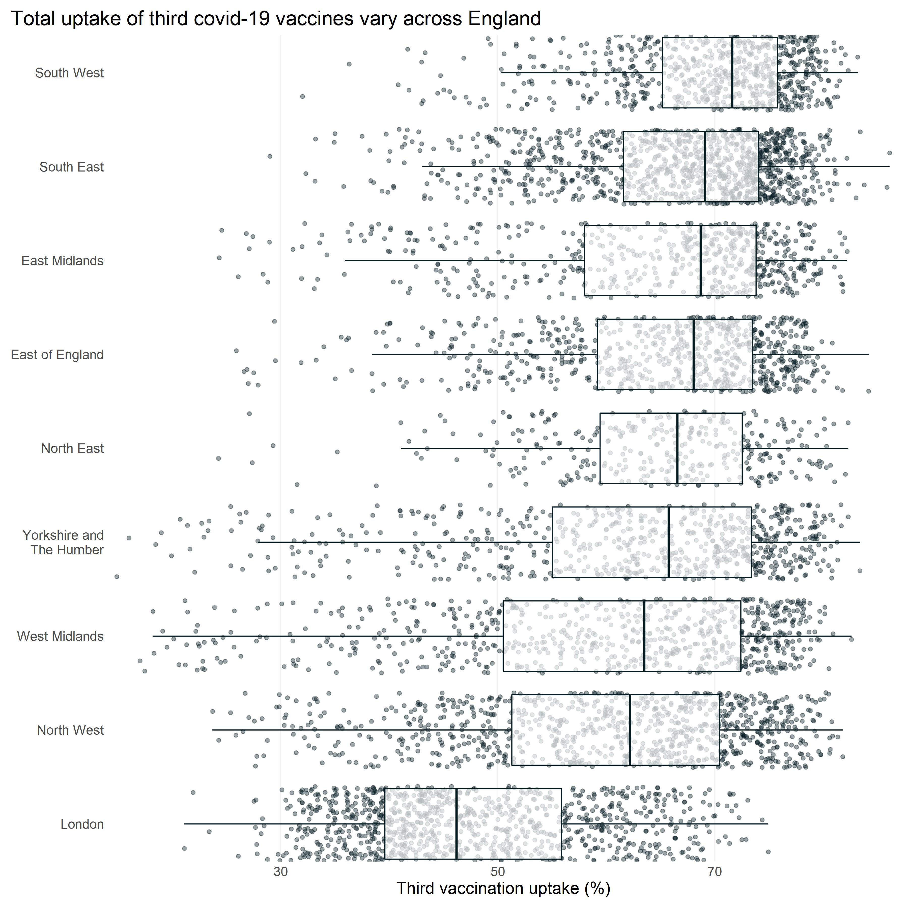
Altered axis and margin spacings with scale_x_continuous(), scale_y_discrete(), and theme()
Slide 26

Slide 27
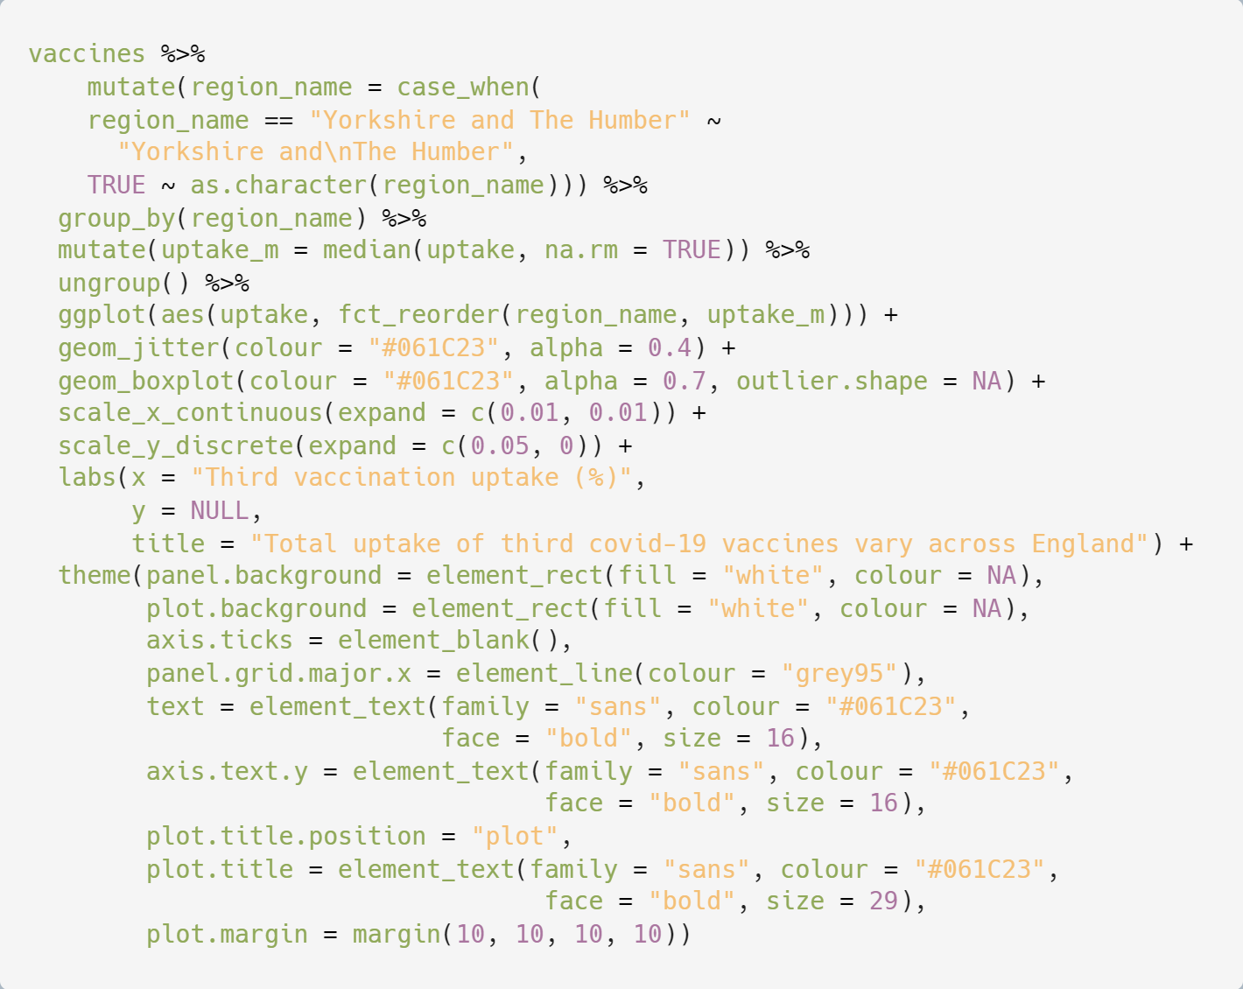
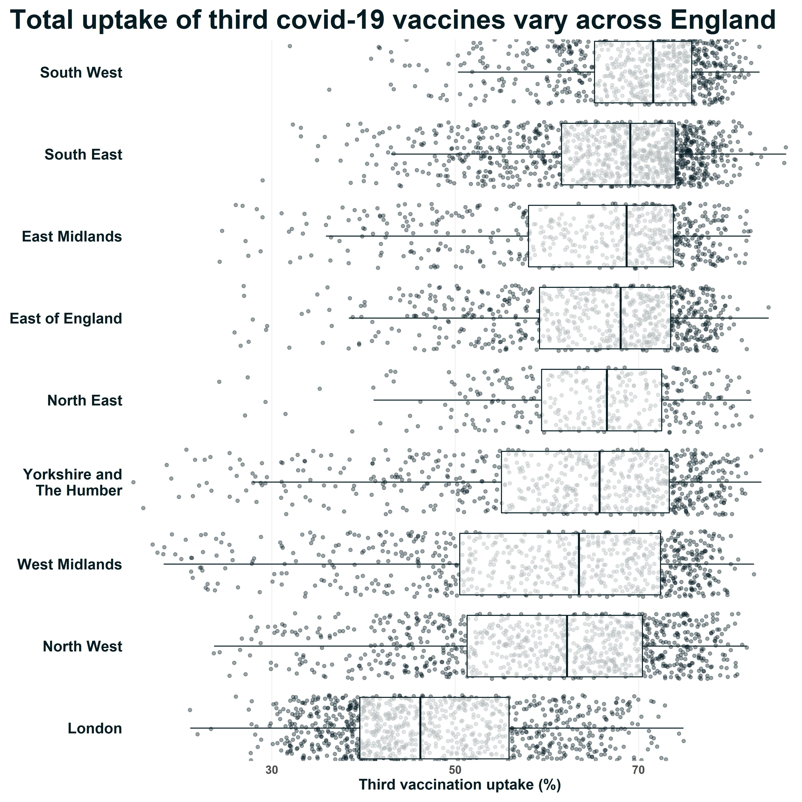
Increased text size further, changed font, and altered colours with theme()
Slide 27

Slide 28
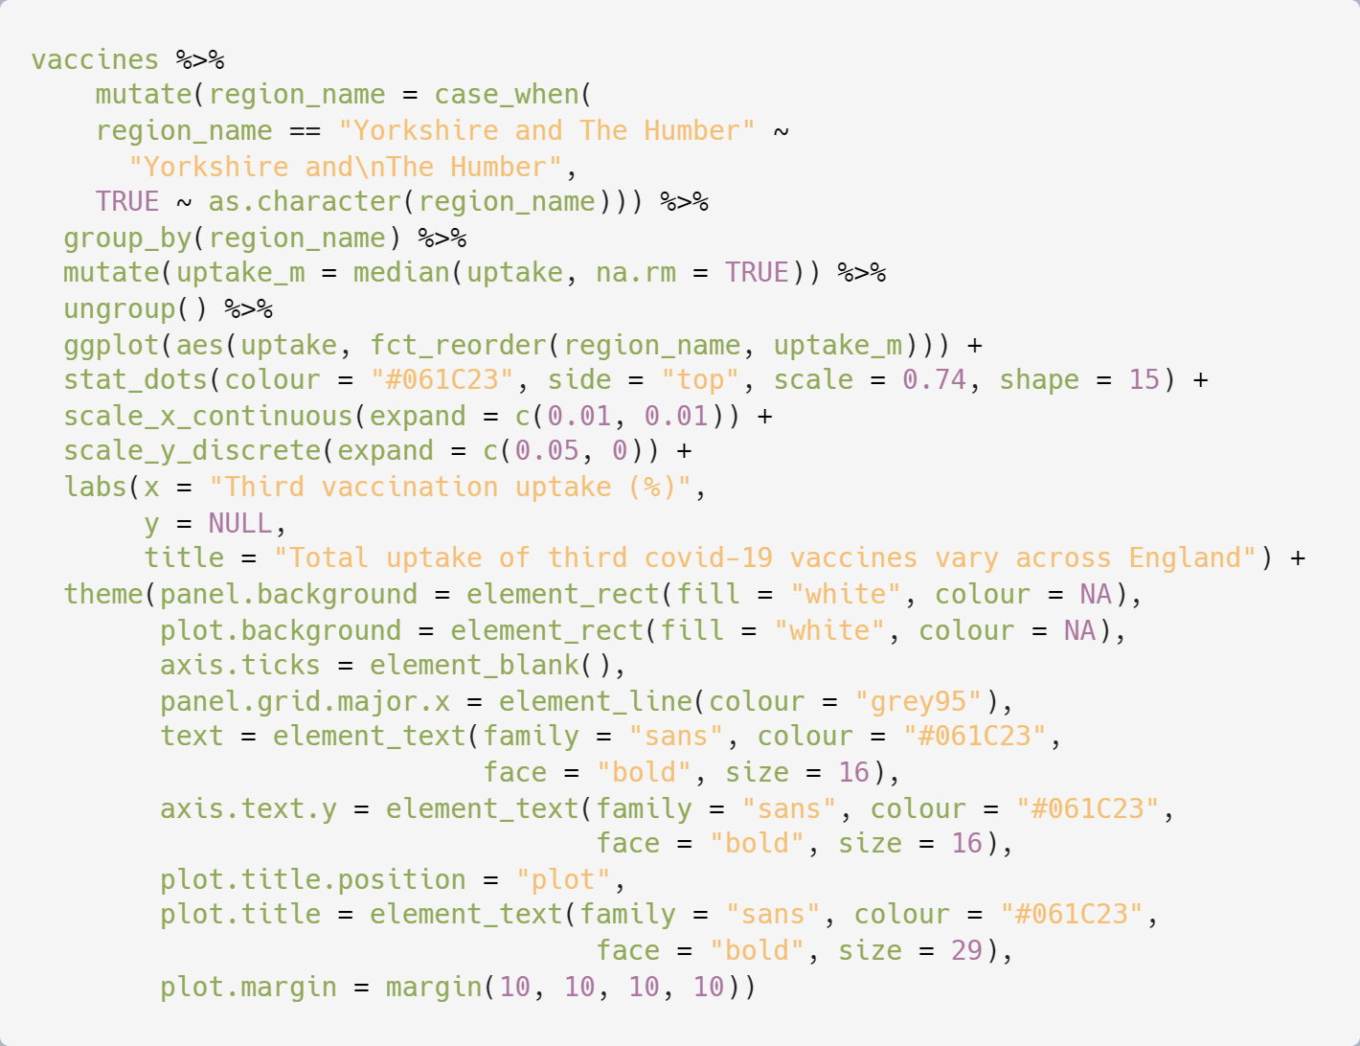
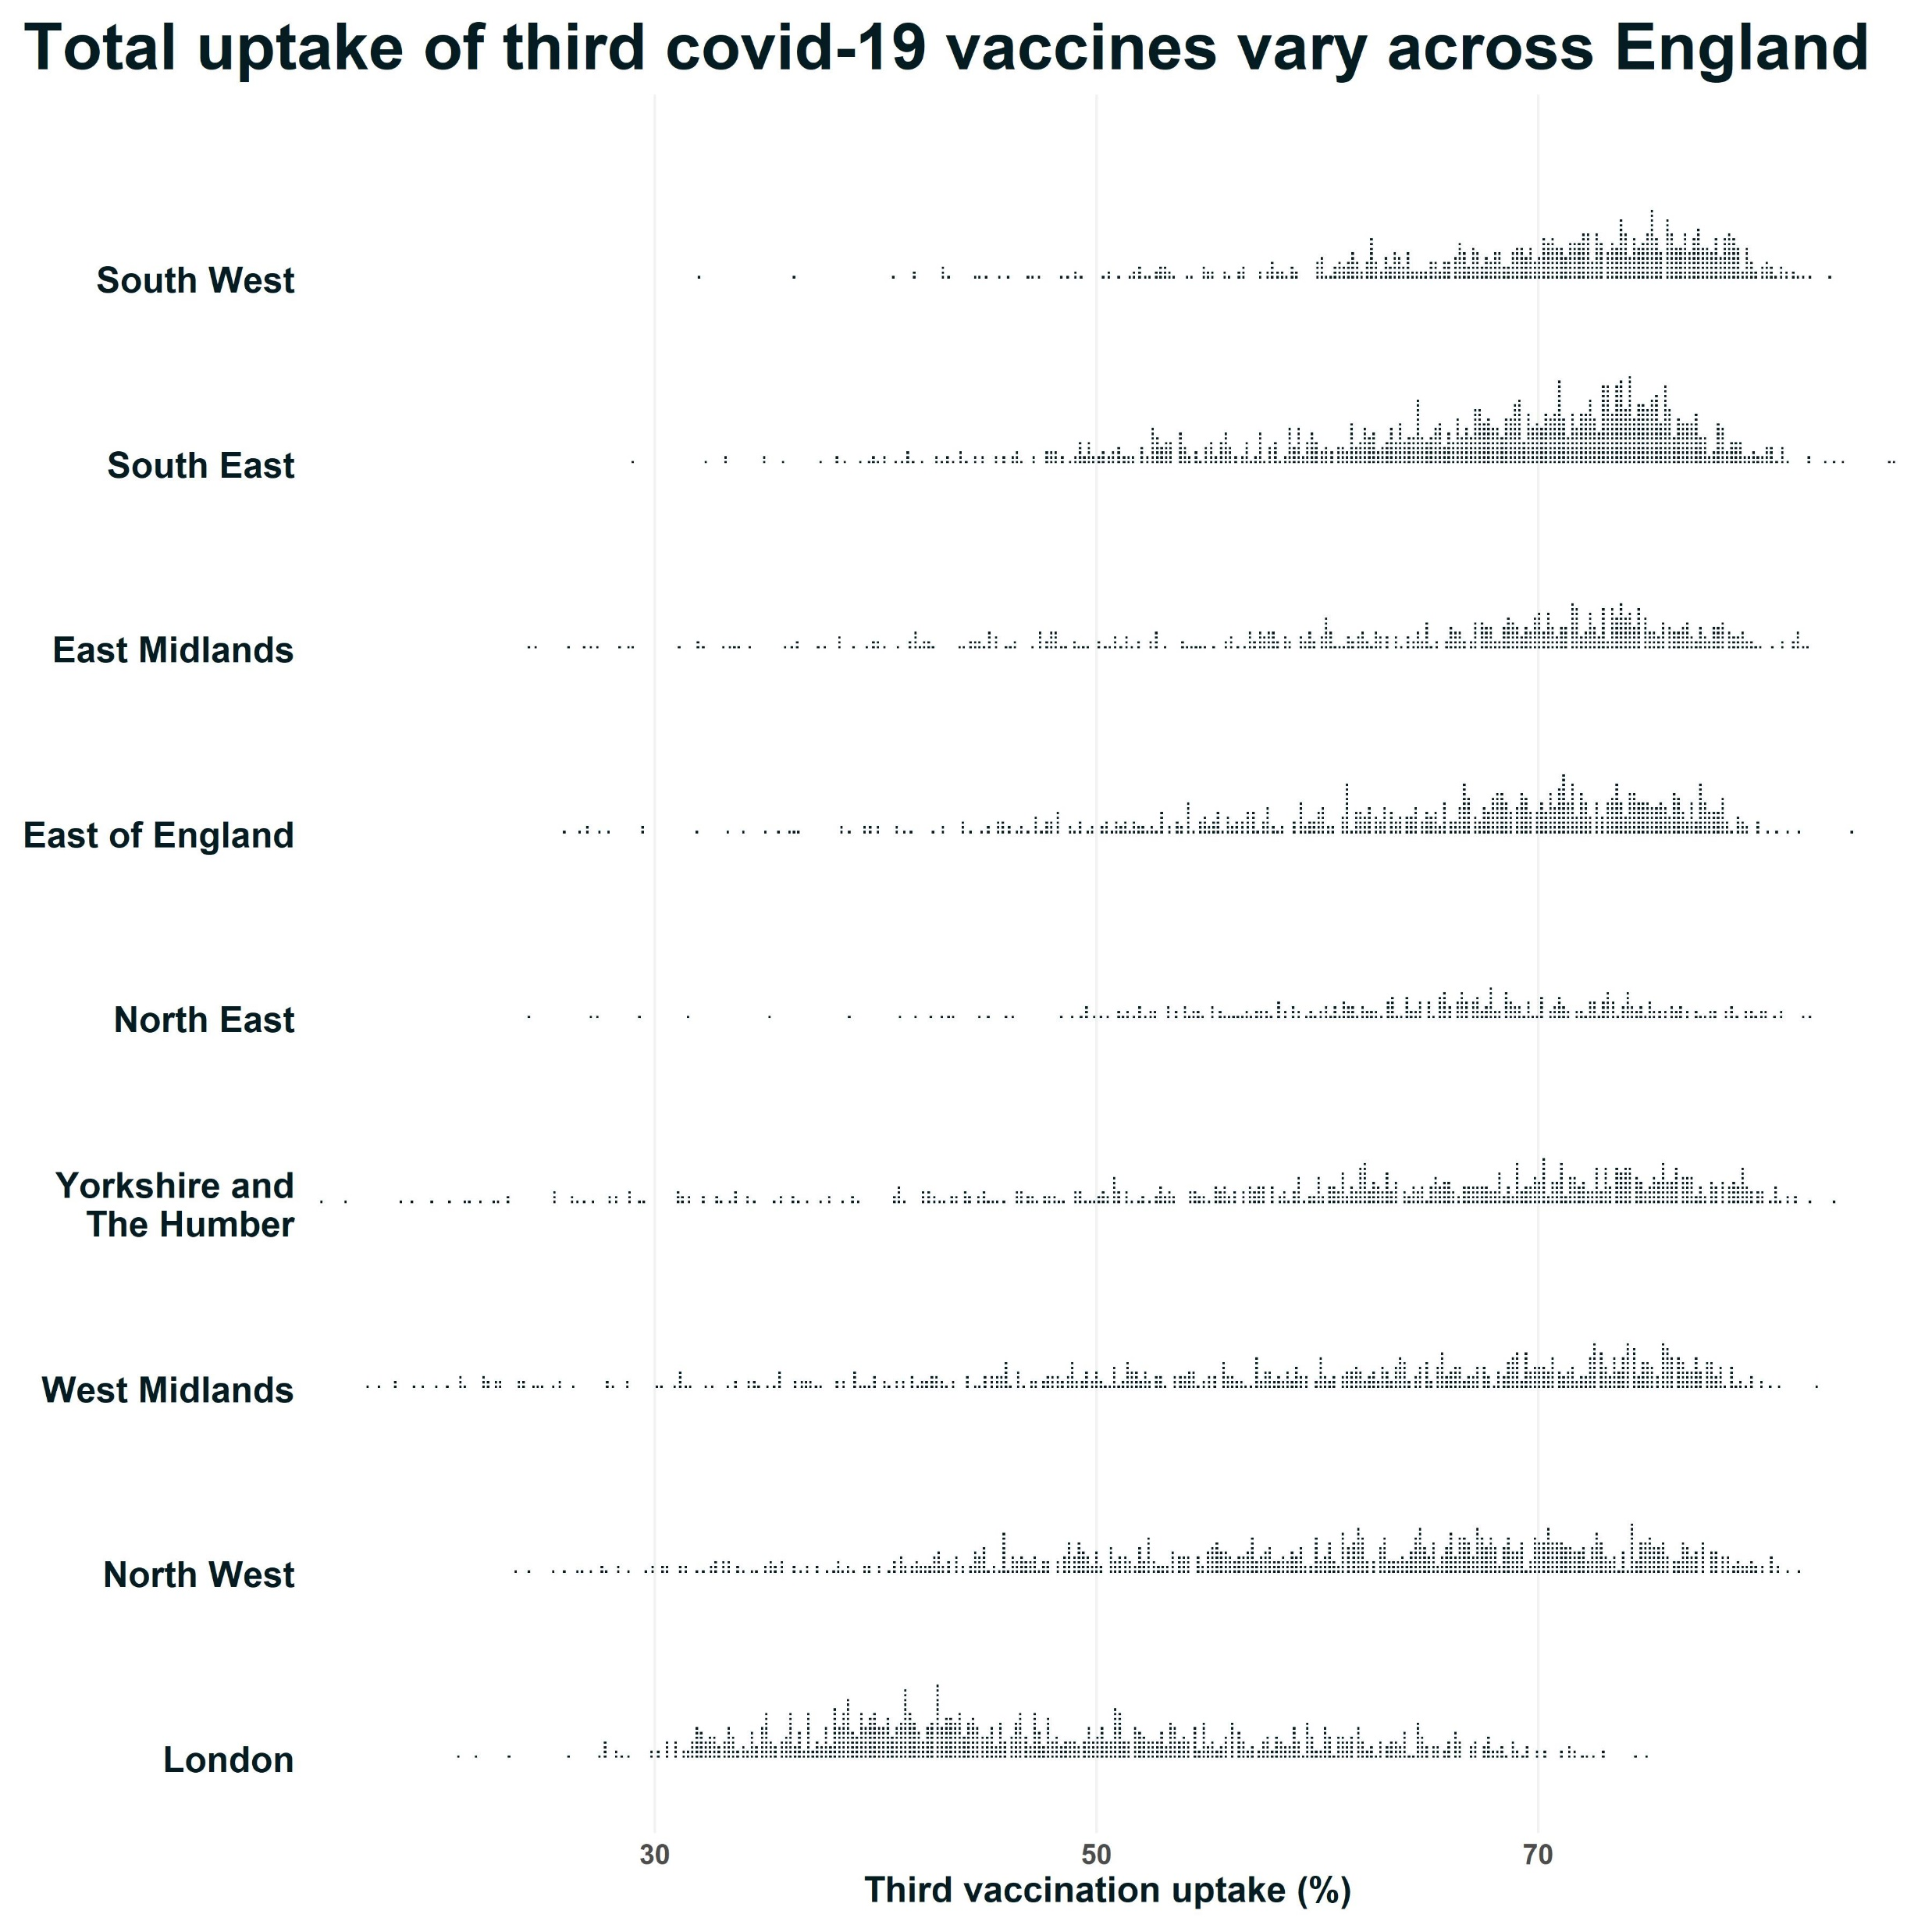
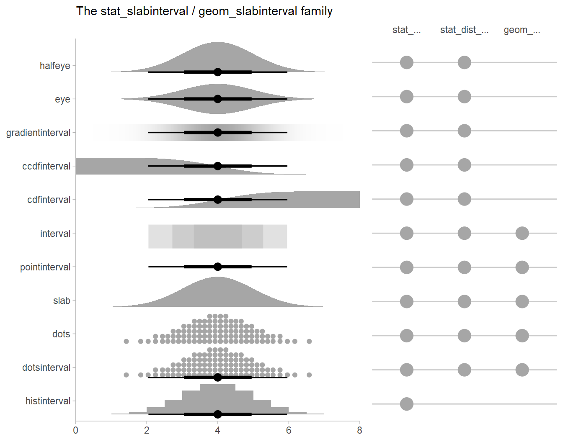
Replaced the points and boxplots with stat_dots() from the ggdist package
Slide 28

Slide 29
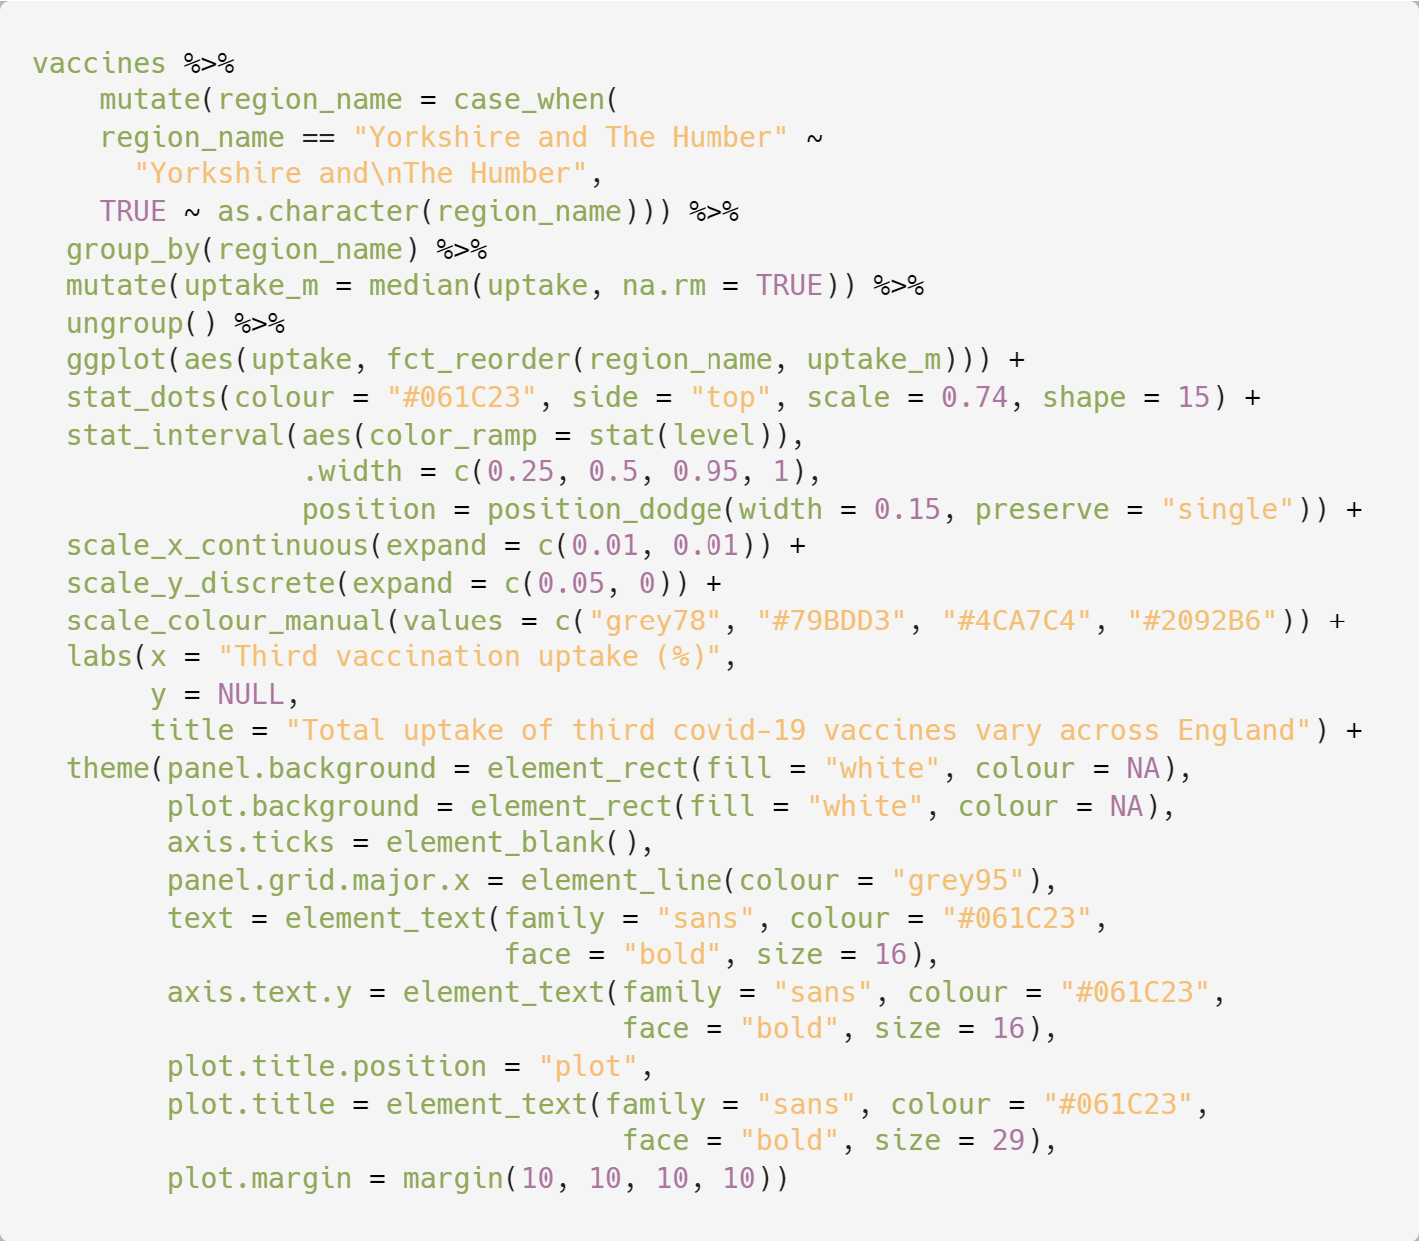
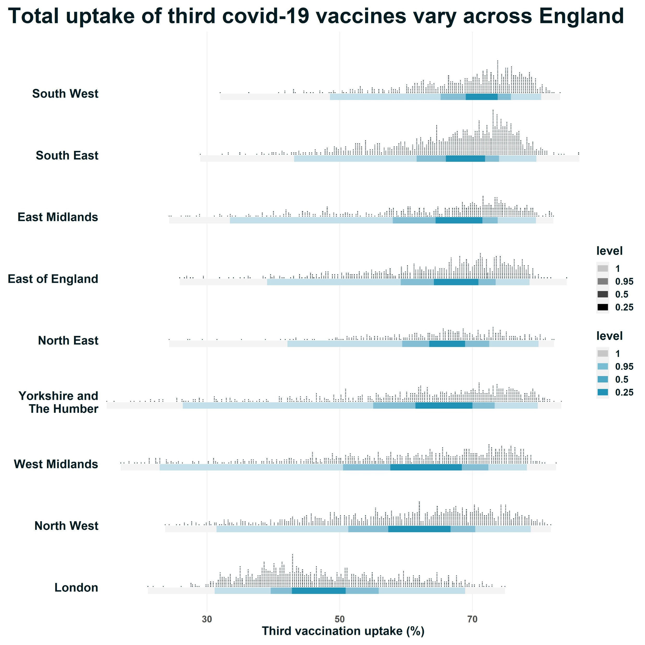
Also included stat_interval() to indicate where 25%, 50%, 95%, and 100% of the MSOAs lie.
Slide 29

Slide 30
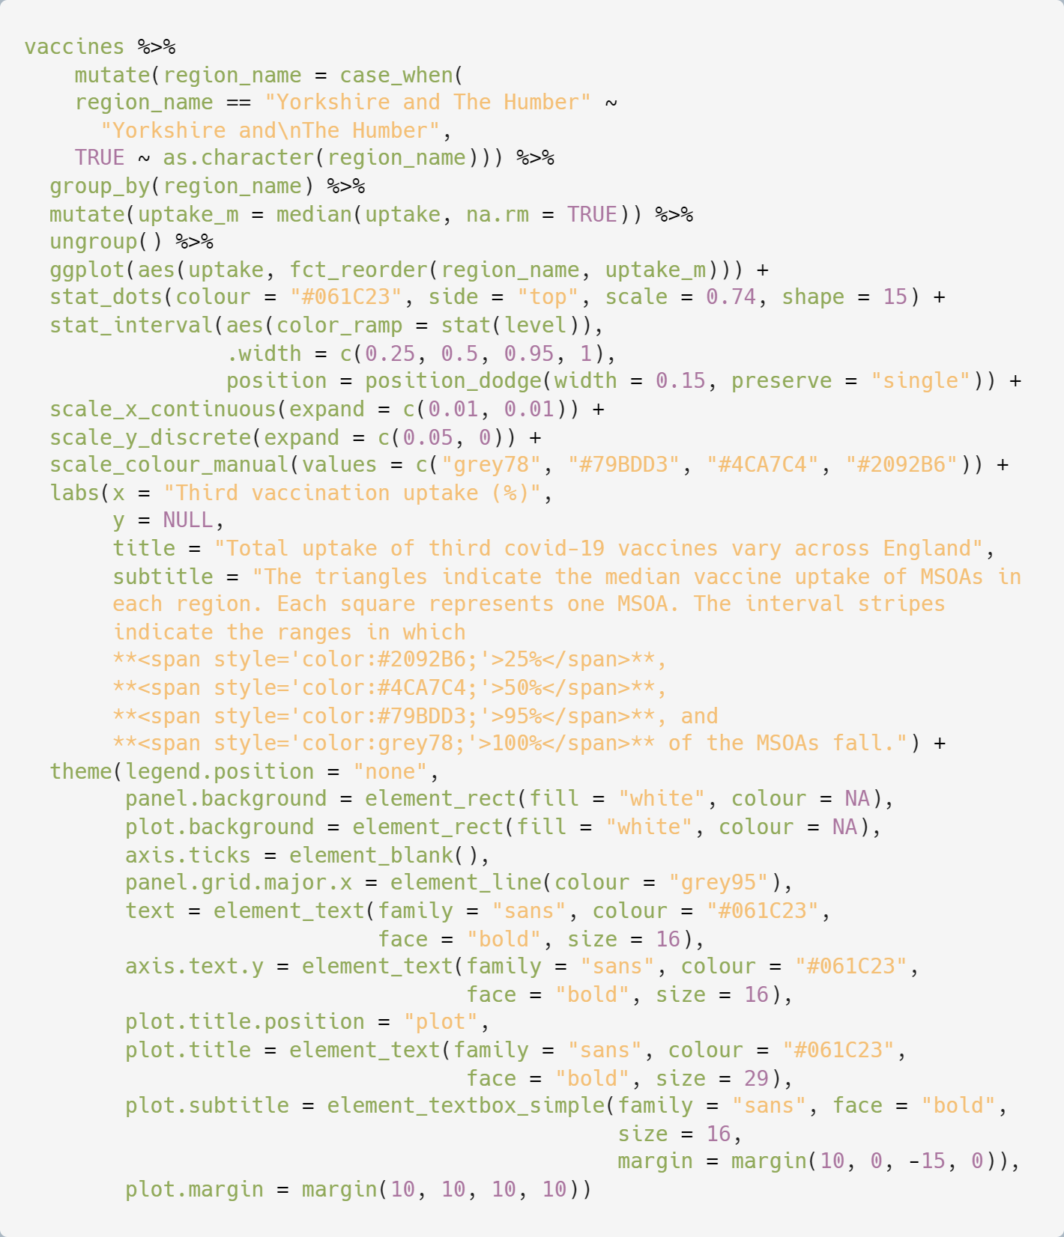
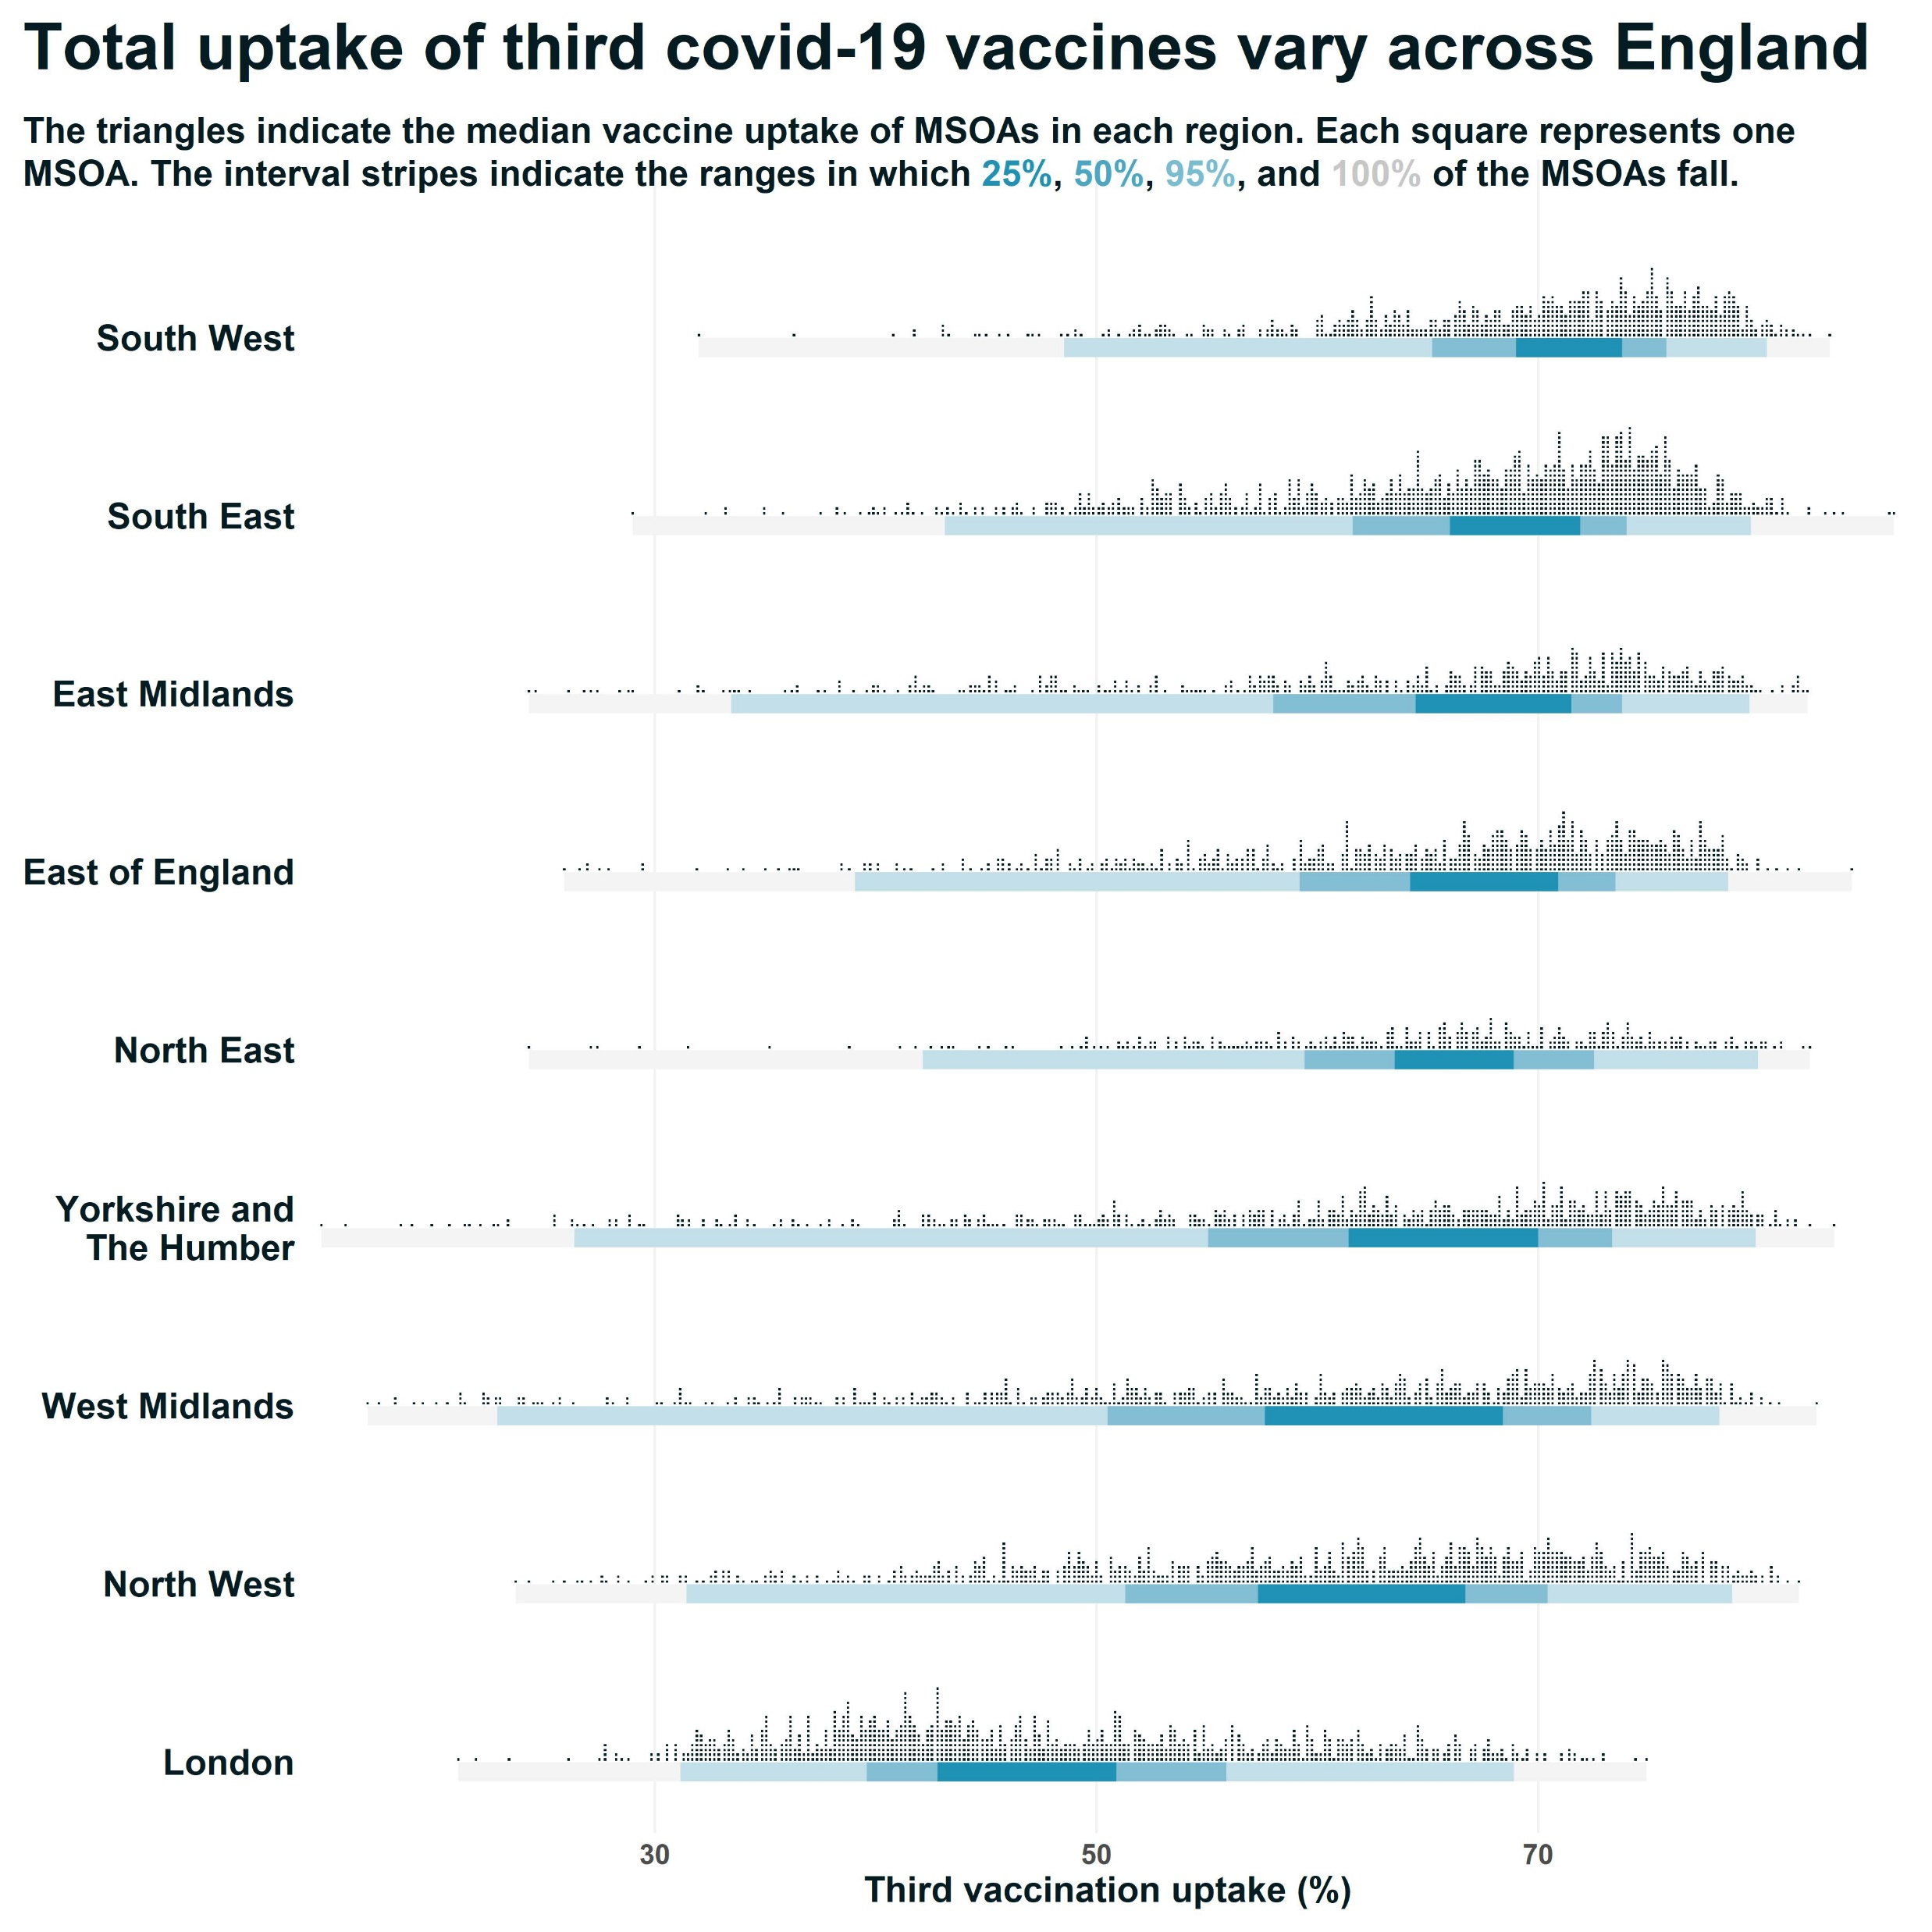
Decluttered by replacing the legend with a colour coded subtitle, using the ggtext package
Slide 30

Slide 31
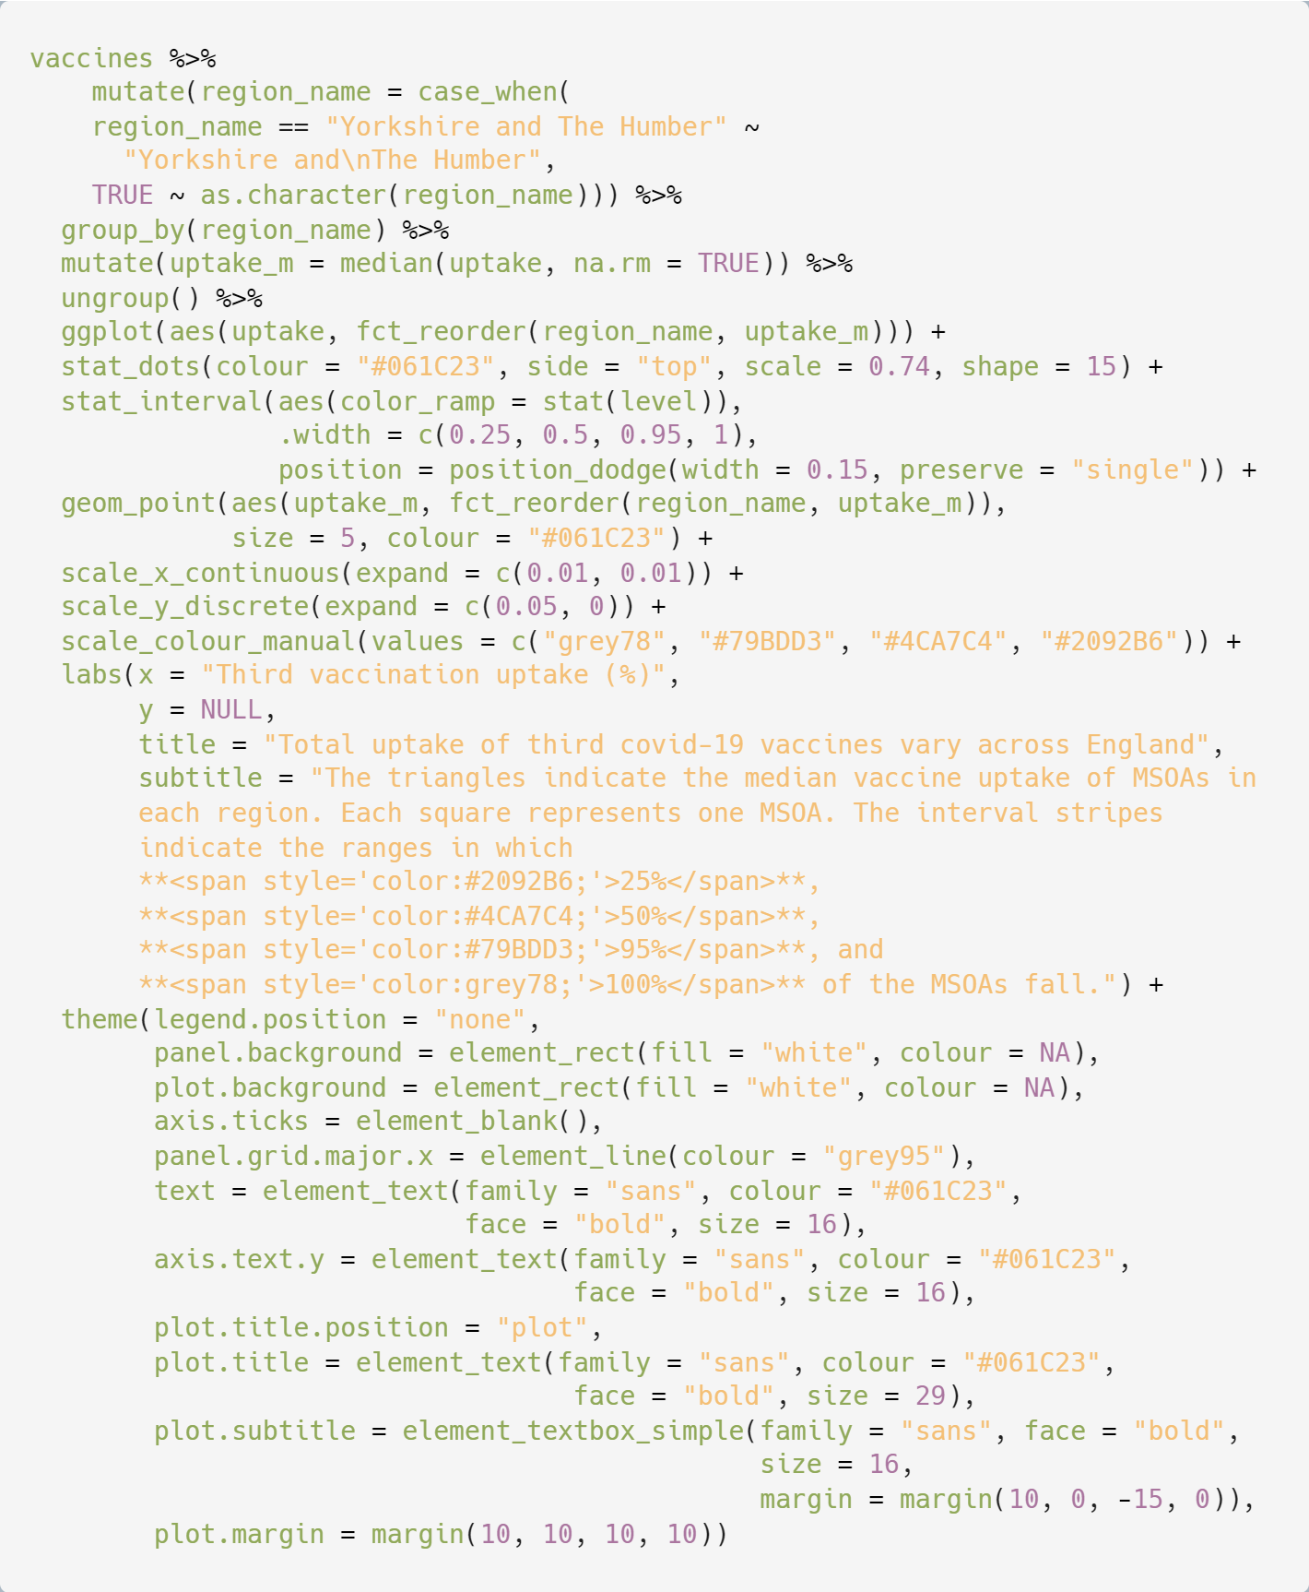

Added geom_point() to plot the median values only
Slide 31

Slide 32
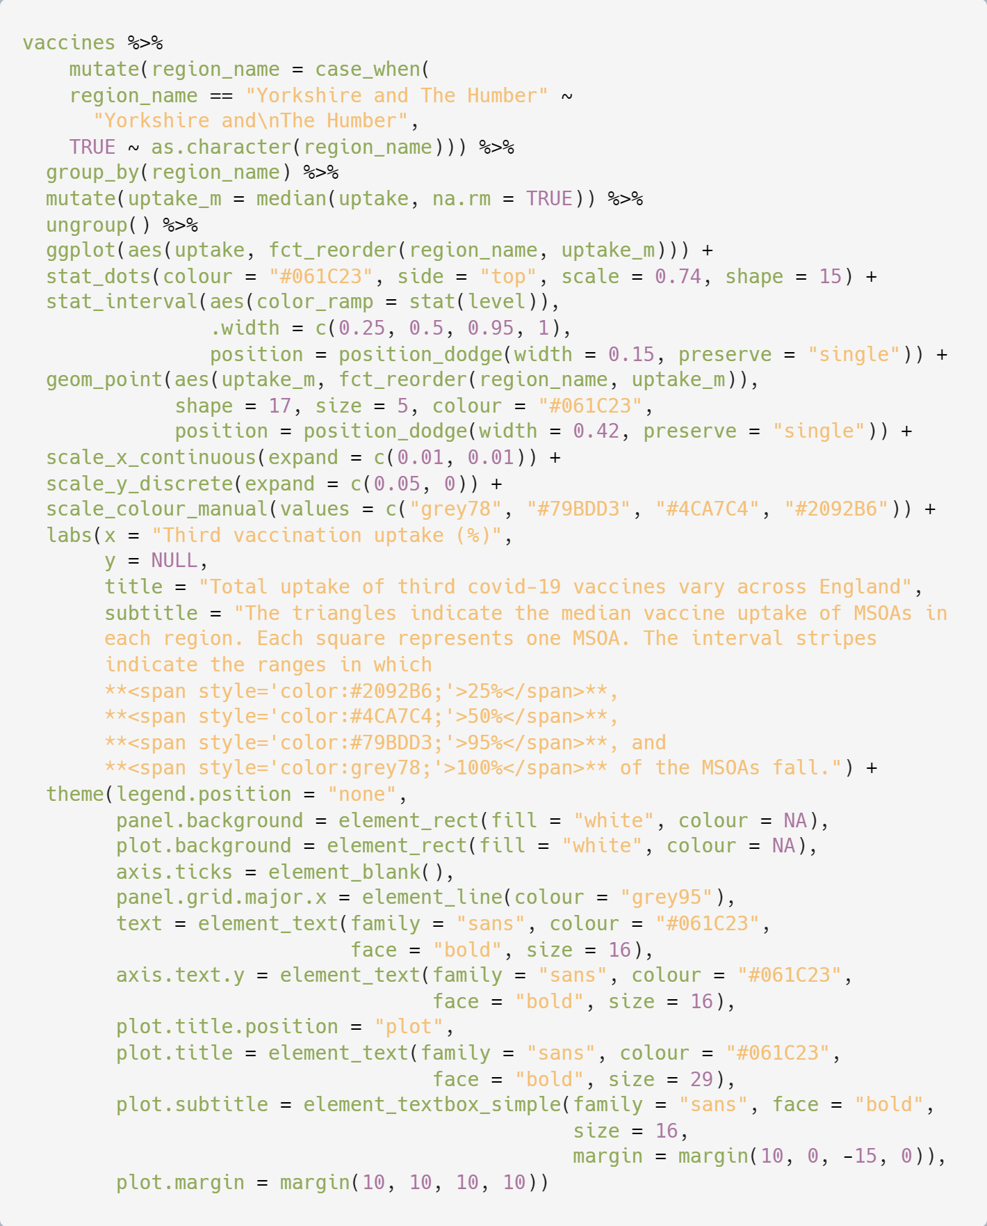

Altered the median point shape and position
Slide 32

Slide 33
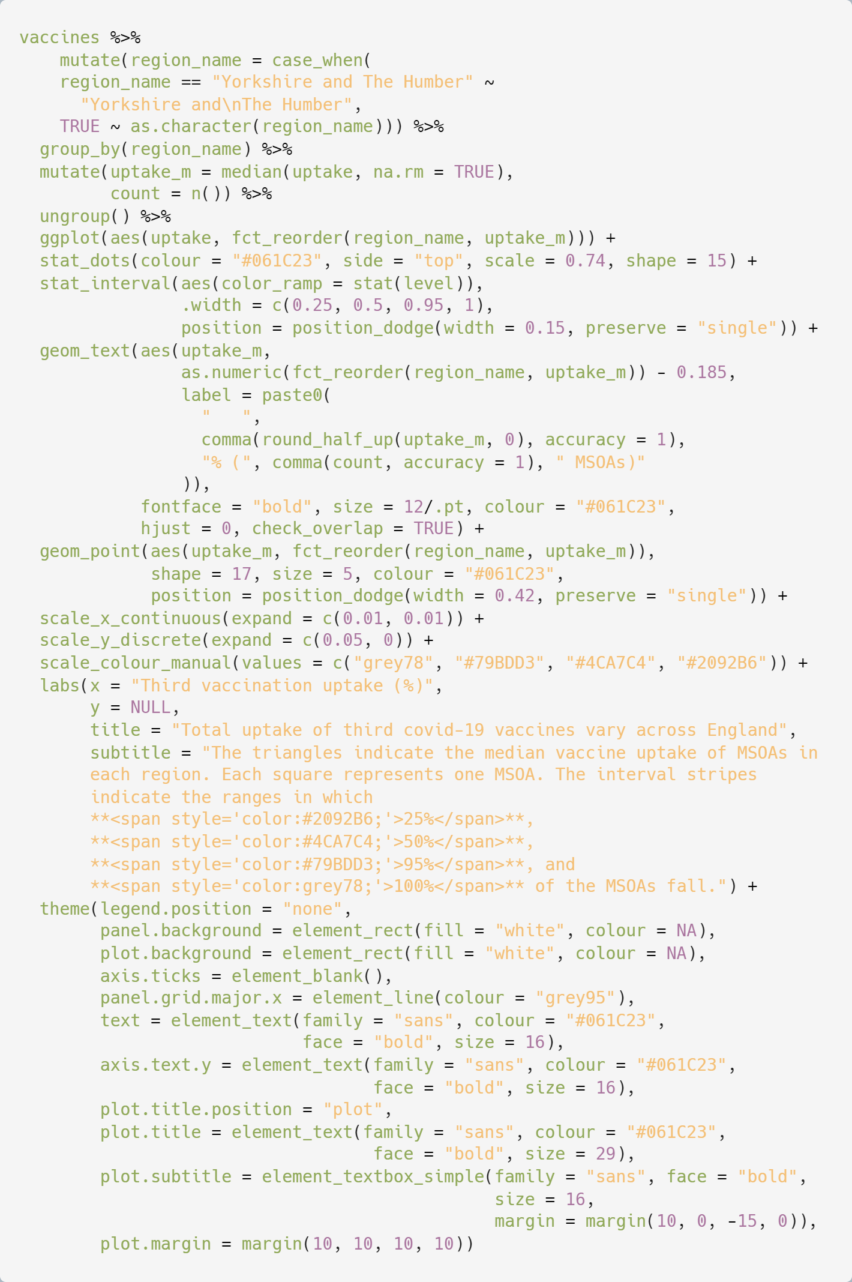
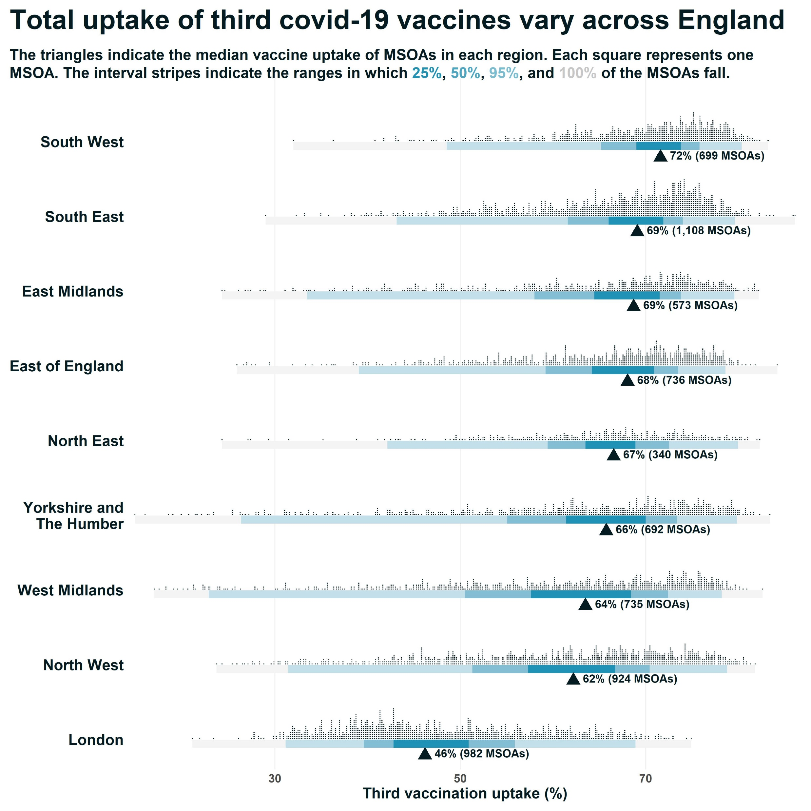
Added geom_text() labels to include the counts of MSOAs
Slide 33

Slide 34
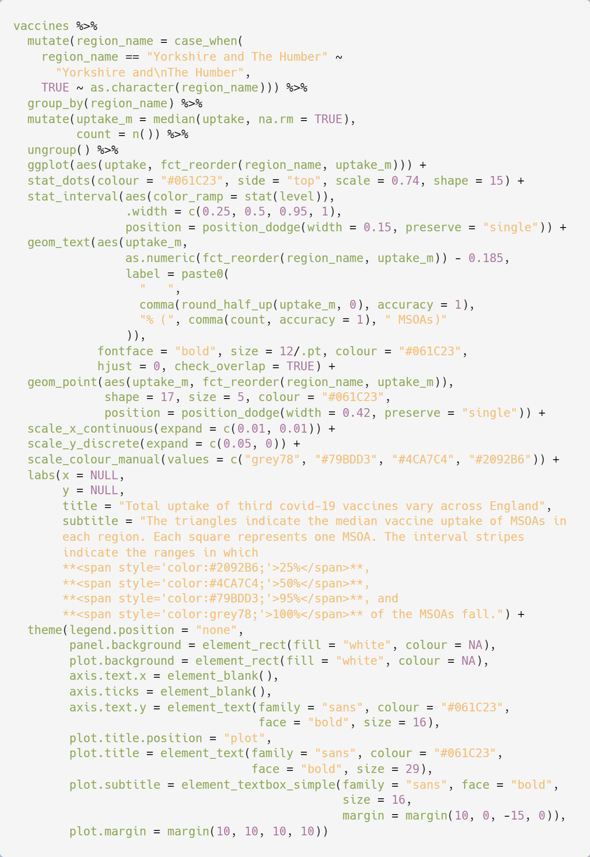
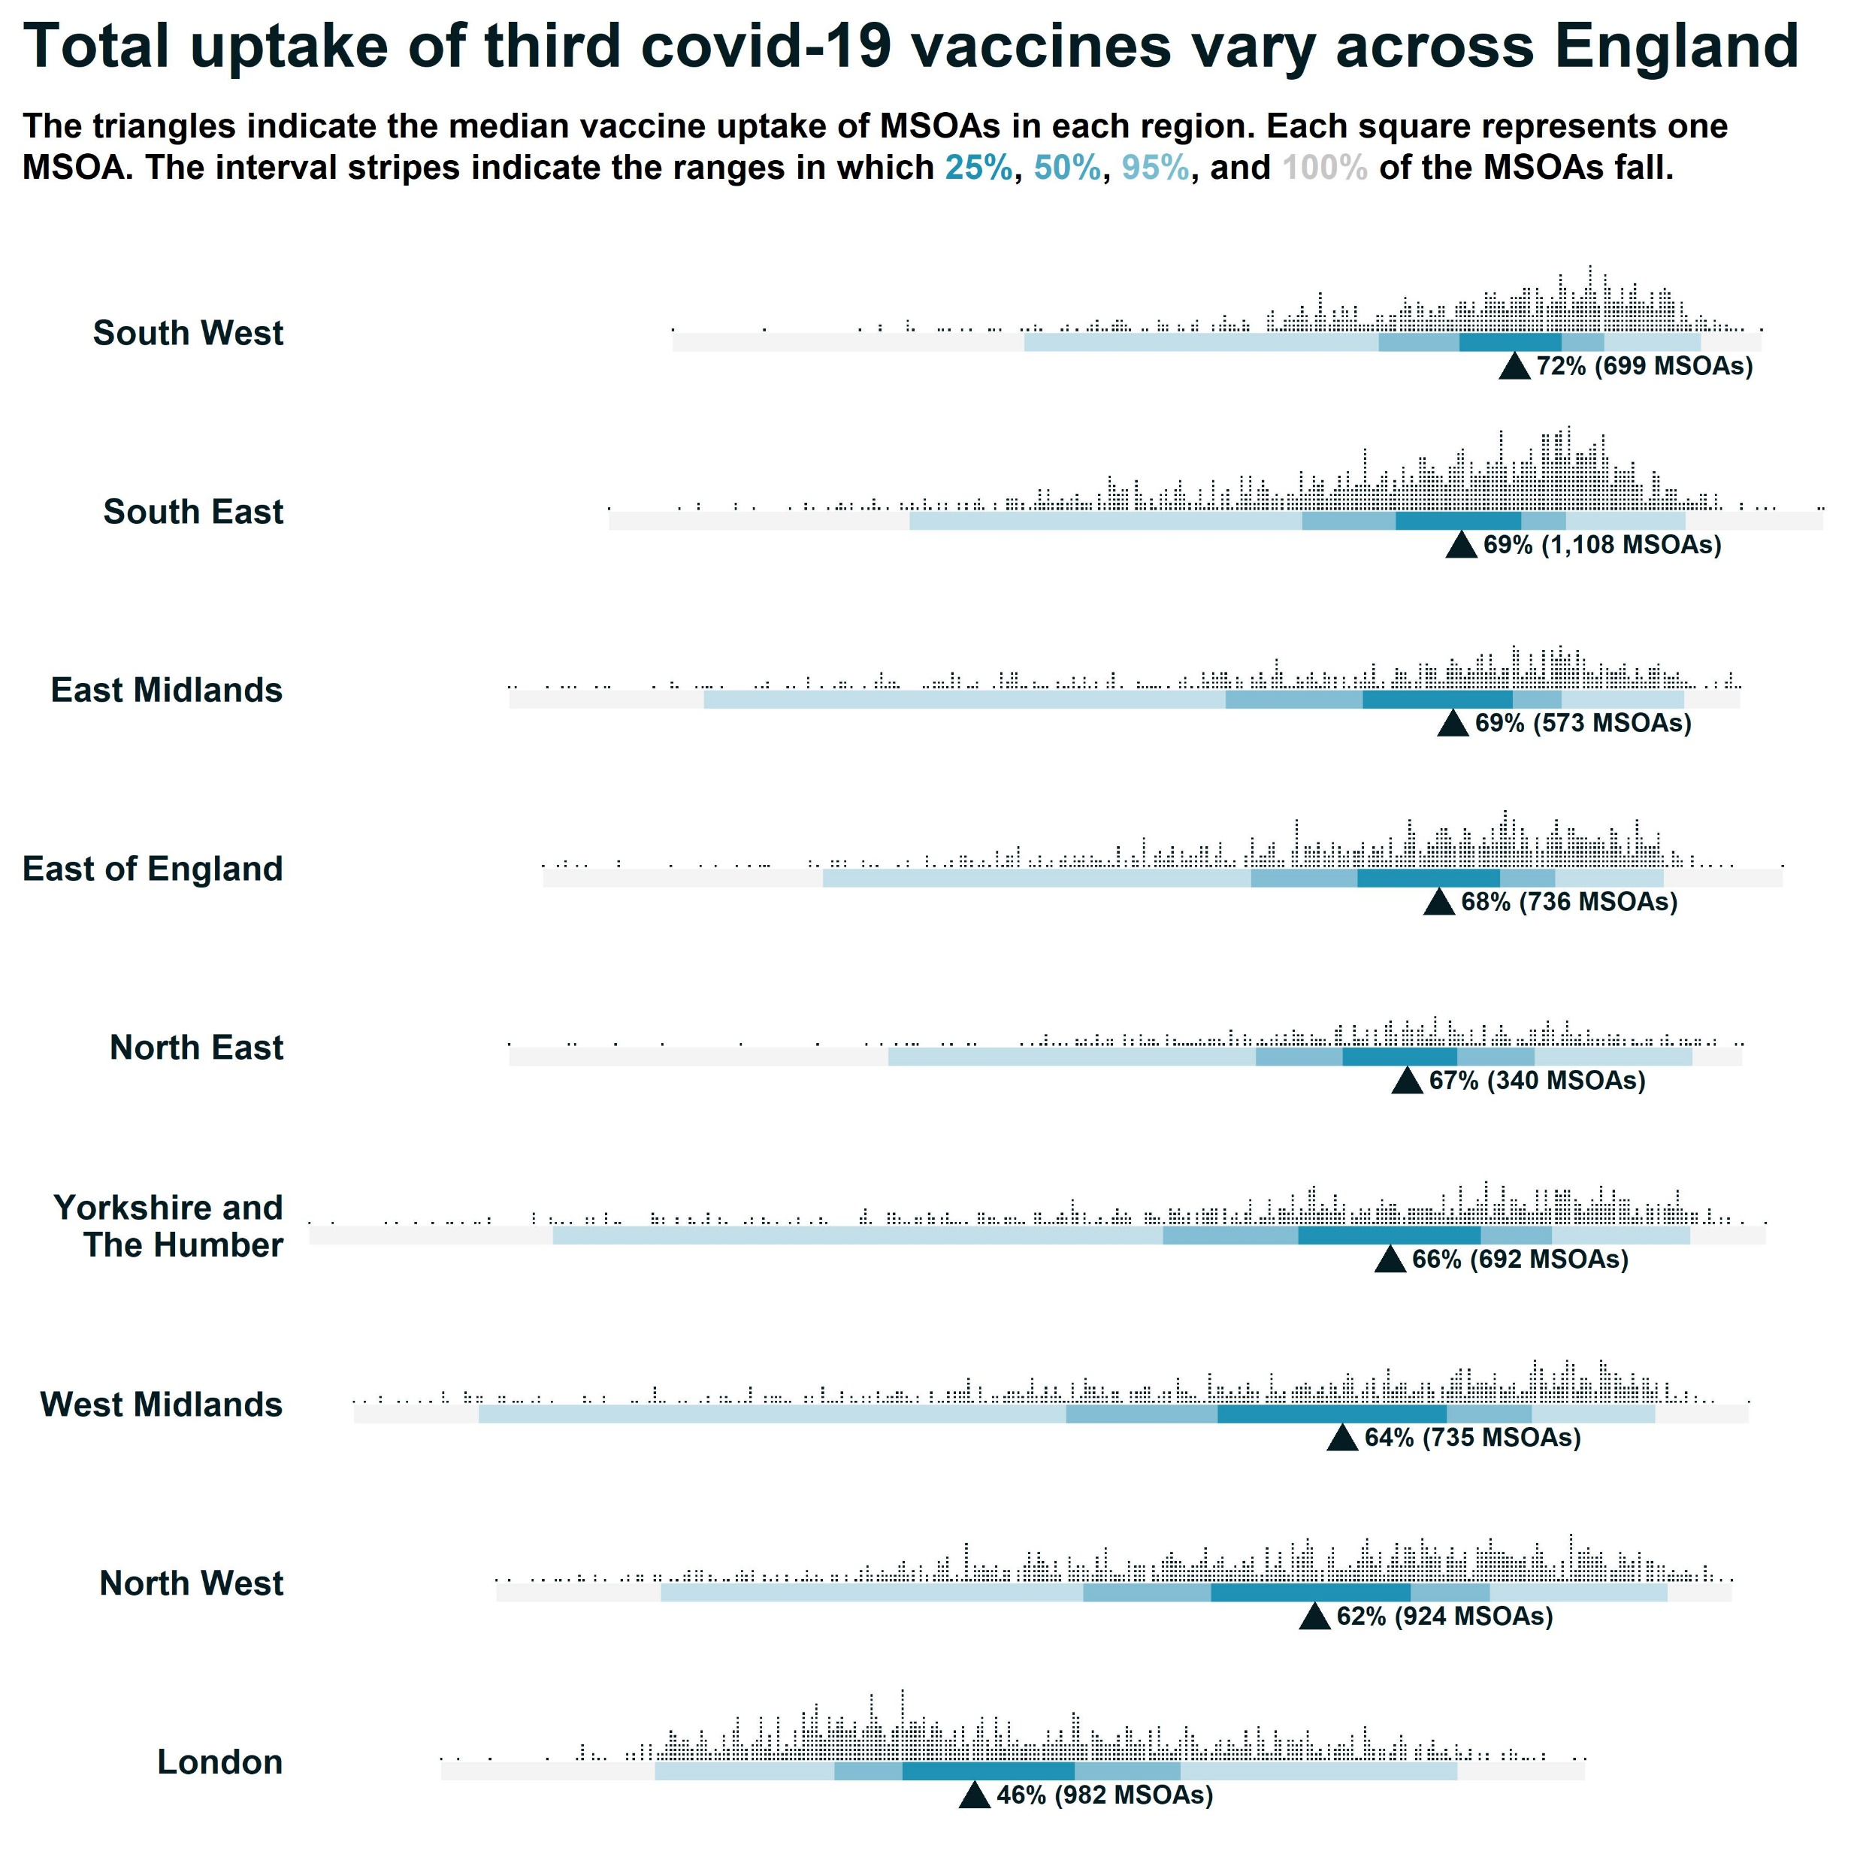
Decluttered by removing the x axis entirely.
Was this a good idea?
Slide 34

Slide 35

Save the plot in any size/format using ggsave()
Slide 35

Slide 36
Showcase: R packages designed as extensions to ggplot2
Slide 36

Slide 37



The ggforce package
Notes:
All taken from: https://github.com/z3tt/OutlierConf2021

Slide 38





The ggsankey package
Notes:
Top left three: https://github.com/davidsjoberg/ggsankey
Bottom left: https://github.com/z3tt/OutlierConf2021
Ebb & Flow, from R Ladies talk: https://www.cedricscherer.com/slides/RLadiesTunis-2021-favorite-ggplot-extensions.pdf

Slide 39


The ggdist package
Notes:
Left: https://mjskay.github.io/ggdist/
Top: https://github.com/z3tt/OutlierConf2021
Bottom right: https://tuowang.rbind.io/post/2021-04-05-ggplot2-extensions-part2/

Slide 40



The ggraph package
Notes:
Network of wine descriptions: https://twitter.com/spren9er/status/1133888948051304448/photo/2
Network of UN voting patterns: https://twitter.com/JDavison_/status/1374371809475260419/photo/1
Hierarchical edge bundling: https://twitter.com/thomasp85/status/694282772714754050/photo/1

Slide 41


The GGally package
Notes:
Left: https://www.blopig.com/blog/2019/06/a-brief-introduction-to-ggpairs/
Right: http://www.i-deel.org/blog/r-statistical-modeling-via-biologists-dialogues

Slide 42

The sf package
(+ biscale)
Slide 42
Notes:
https://timogrossenbacher.ch/2019/04/bivariate-maps-with-ggplot2-and-sf/

Slide 43


The ggiraph package
Slide 43

Slide 44
Where / how to learn more
Slide 44

Slide 45


Online tutorials
Collection of ggplot2 teaching material from Cédric Scherer: https://github.com/z3tt/ggplot-courses
A more comprehensive collection from Erik Gahner Larsen: https://github.com/erikgahner/awesome-ggplot2
Slide 45
Notes:
Evolution of a ggplot: https://www.cedricscherer.com/2019/05/17/the-evolution-of-a-ggplot-ep.-1/

Slide 46

The esquisse package
For anyone who wants to start using ggplot2 without getting bogged down in syntax.
Slide 46
Notes:
https://github.com/dreamRs/esquisse
“Ess-keys”

Slide 47



R Graph Gallery
Lots of inspiring chart designs and code examples to copy
Slide 47
Notes:
https://www.r-graph-gallery.com/

Slide 48

Slide 48

Slide 49

Slide 49

Slide 50

github.com/AndyABaker/TidyTuesday

Slide 51

Code from this session
The code from my examples in this session is now available on the Coffee and Coding GitHub repo
Slide 51

